Slide 1
The Environmental Impacts of Waste
Lesson 4
NetWaste Teacher Resource for primary schools

Slide 2
Where does it come from?
Have you every stopped to think where the things we use every day come from? We might buy these products from a shop or supermarket, but what are they actually made from?
Did you know that everything we use, eat, buy or wear comes from the natural environment.
We call these natural resources or raw materials.
Notes:
Have a class discussion about where everyday items come from.

Slide 3
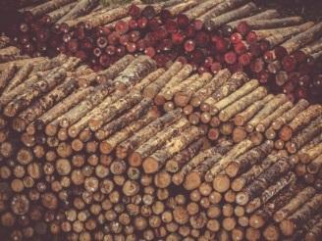
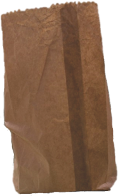
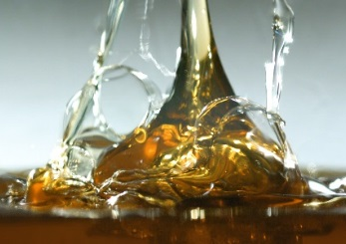
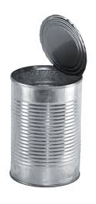
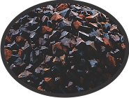
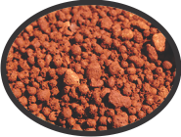
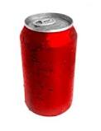
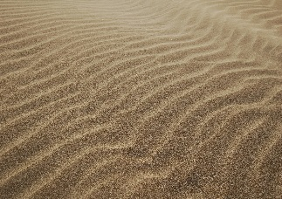
Natural resources for everyday items
Paper and Cardboard
Trees
Oil
Plastic
Iron Ore
Steel
Bauxite
Aluminium
Sand, Limestone and Soda Ash
Glass
Notes:
What are natural resources? Give some example such as trees, minerals, oil etc. Discuss the impact that mining or extracting natural resources may have on the environment.
Why do we mine natural resources from the environment? Ask the students to brainstorm the resources that are required to make common everyday items

Slide 4
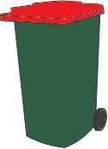
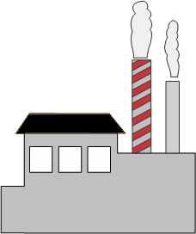
Paper
?
Notes:
Paper
Trees, a natural resource, are required to produce paper products.
Ask students to consider the environmental impacts of cutting down trees.
Trees remove carbon dioxide from the atmosphere and produce oxygen.
Trees also provide important habitats (homes) for Australian native animals. It takes many years for a tree to mature to an age where it is able to provide these benefits.
Ask the students to consider the energy required to cut down, transport and process the trees needed to produce paper products, and the emissions released during these processes
Paper products are ideally recycled. This reduces the need for trees to be cut down to create new products and creates a ‘closed loop’.
Paper cannot be recycled indefinitely, and new material is required to be added to maintain a high standard of fibre.

Slide 5
Plastic bottles
?
Notes:
Plastic Bottles
Plastic bottles and containers are made from crude oil. Crude oil is a naturally occurring, unrefined petroleum that has formed over millions of years by the decomposition of plants and animals compressed under a thick layer of mud and rock. As such, crude oil is a non-renewable resource.
Mining for crude oil can be risky and can lead to oil spills and environmental harm.
Mining, transporting and refining crude oil is highly energy intensive and produces a large amount of emissions.
Ideally, plastic bottles are recycled to reduce the volume of crude oil that is required to be extracted in order to produce new plastic products. Recycling plastic bottles and containers can create a ‘closed loop’ system, where crude oil as a resource, and the energy required to produce plastic, is not lost to landfill.
Unfortunately, not all plastic materials can currently be recycled through the kerbside recycling service e.g. plastic bags and other soft plastics are considered non-recyclable

Slide 6
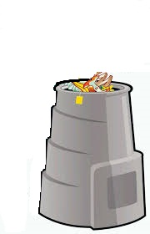
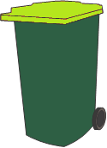
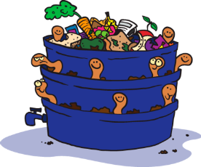
Apples
?
Notes:
Apples
Ask students to consider the energy required to produce food. This includes the energy required to plant seedlings and maintain the growth of plants (including water, fertilisers, sunlight, man-power and energy required for machinery), the energy required for transporting and processing the food (fuels, maintenance of road networks, electricity and man-power), and the energy required to advertise and sell the food.
What happens to organic waste when we throw it away? The breakdown of organic materials in landfill produces a large quantity of methane gas and leachate.
By organically recycling our organic food scraps (through the use of either a worm farm, compost bin or you might have a Food & Garden Waste Bin) we are able to create a nutrient rich soil enhancer, which can be returned to the soil to help to grow new fruit and vegetables.

Slide 7
What else do we use and where does it come from?
Notes:
What else?
Ask students to brainstorm or research other similar natural resources and the products we produce with them. Have students consider the impact we may have if we continue to extract natural resources from the environment e.g. Natural habitats become disrupted and destroyed, water courses disrupted or reduced, production lines and factories produce pollutants into our atmosphere
Have a class discussion about all the other factors required to mine and manufacture natural resources e.g. land, energy, water, time and people

Slide 8
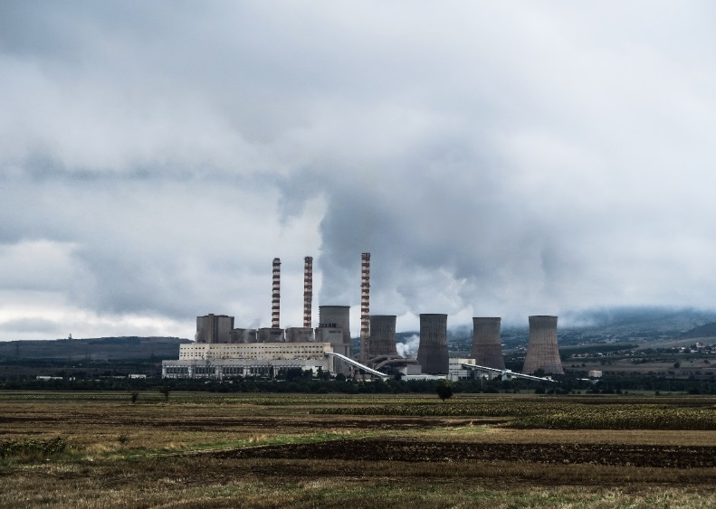
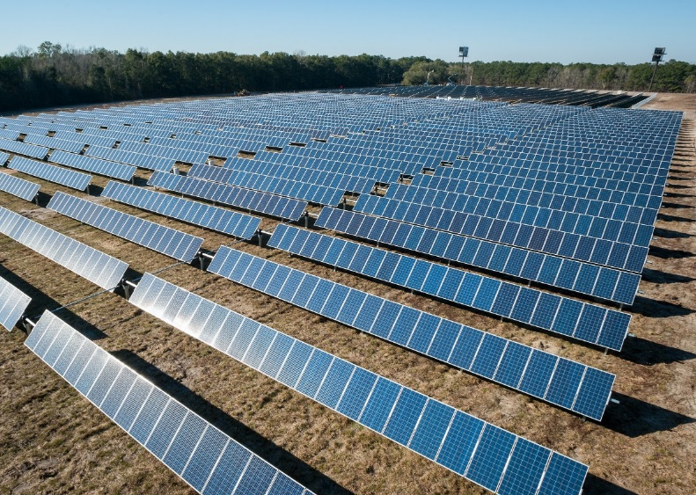
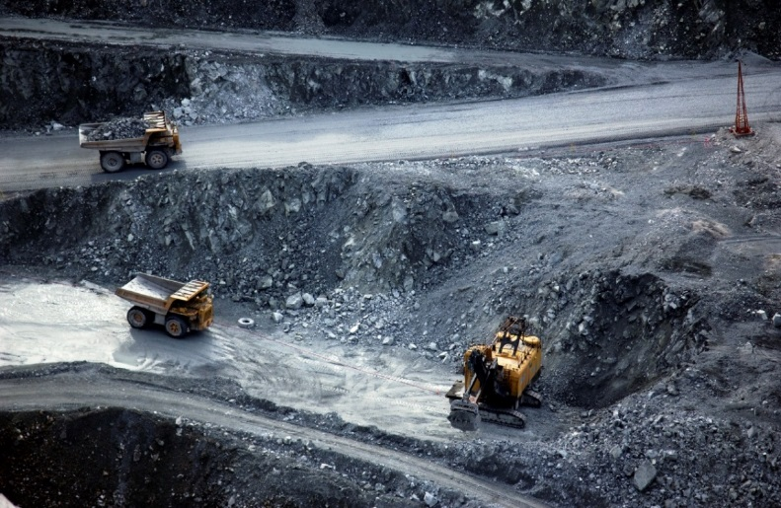
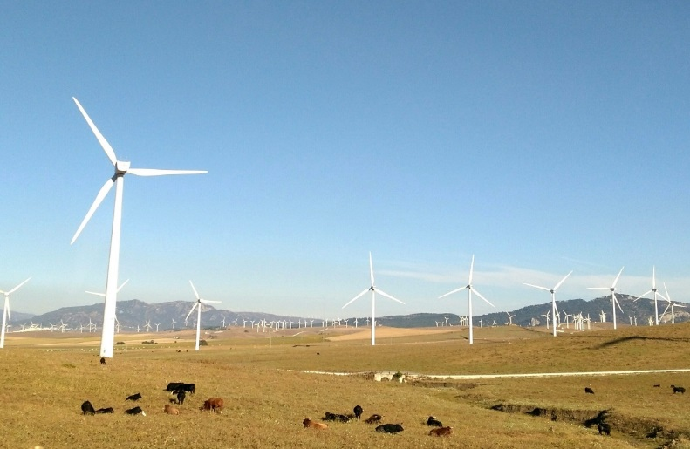
Renewable vs. non-renewable- what is the difference?
Notes:
Introduce the term renewable resources and non-renewable resources to the students. Explain the difference between each and provide some examples
Ask the students to think about some of the impacts of over using non-renewable resources. Introduce the students to the concept of consumerism and human behaviours in a ‘throwaway society’ (i.e. the concept of purchasing a product and the impact of only using it once before it is thrown away).

Slide 9
What happens when waste goes to landfill?
Methane
Leachate
Notes:
Discuss with students what happens when they put their waste in their general waste bin.
Where is the waste taken? All waste that is disposed of in the general waste bin is collected in a rubbish truck and transported to the local landfill. Here the waste is put into a landfill cell and buried. As organic waste materials combine with other waste materials and start to decompose, this can create two major environmental pollutants: methane and leachate.
For further information about landfilling processes, please refer to Lesson 1: Waste and Recycling

Slide 10
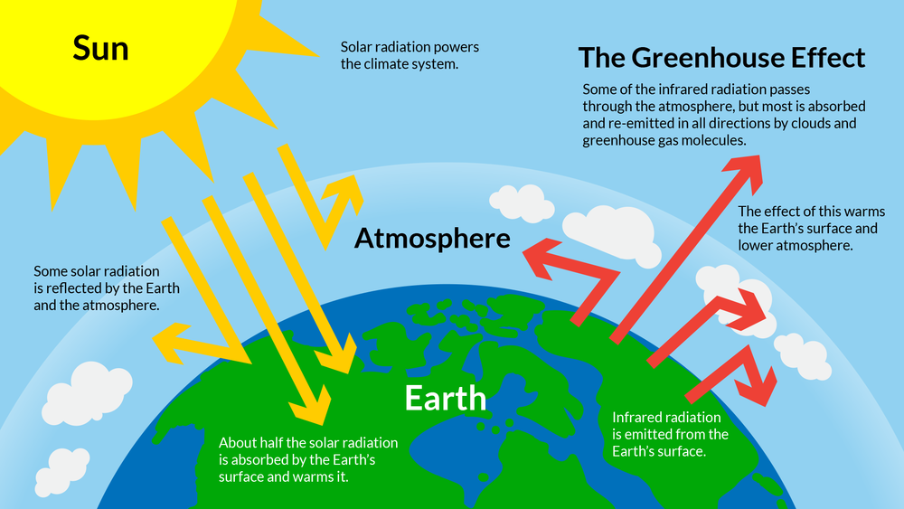
How does methane contribute to climate change?
Notes:
Introduce the concept of Climate Change. Methane, produced in landfill cells, is a greenhouse gas. A greenhouse gas is an atmospheric gas that absorbs and emits radiant energy. This process traps heat between the earth’s surface and atmosphere, causing the greenhouse effect and increasing average global temperatures.
The greenhouse effect can be explained to students by having them imagine they are lying in bed. Continually layering blankets on the bed will increase the temperature until it becomes too hot to be comfortable.
The slide illustrates the transfer of radiant energy from the sun, to the earth, and then out to space. Without the impacts of increased greenhouse gases in the earth’s atmosphere. Radiant energy enters the earth’s environment, with some being reflected back to space by cloud coverage and the atmosphere. Once within the earths environment the majority of radiant energy is reflected by the earths surface back to space with only a small amount reflected from the atmosphere and remaining in the earth’s environment.
The image on the slide illustrates global conditions where the earth's atmosphere is impacted by an increase in greenhouse gases. Radiant energy still travels to the earth’s environment from the sun and enters the earth’s environment, however the increase in greenhouse gases reduces the amount of radiant energy able to be reflected away from the earth’s atmosphere and into space. As more radiant energy is trapped within the earth’s environment the average temperature of the globe is increased.

Slide 11
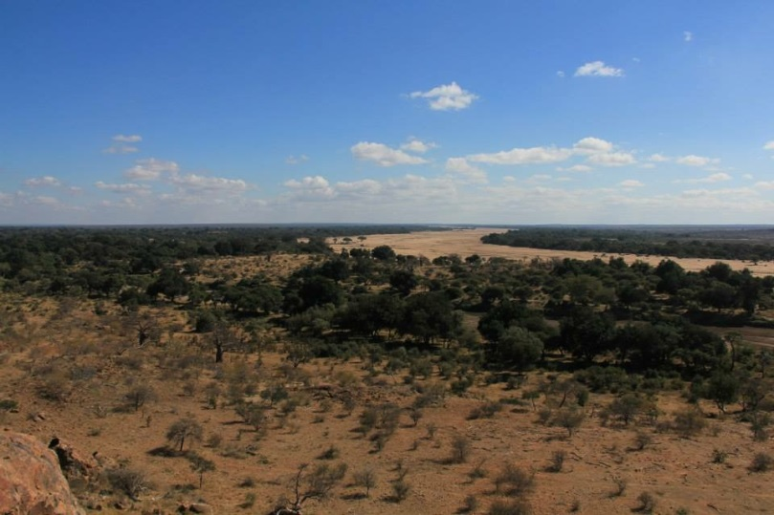
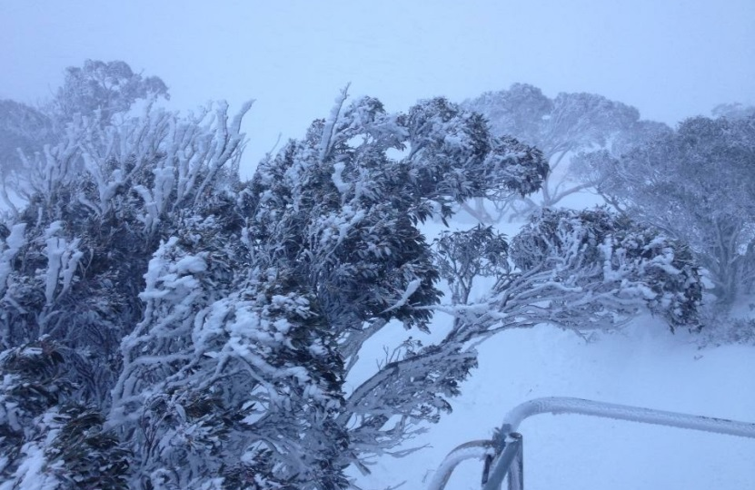
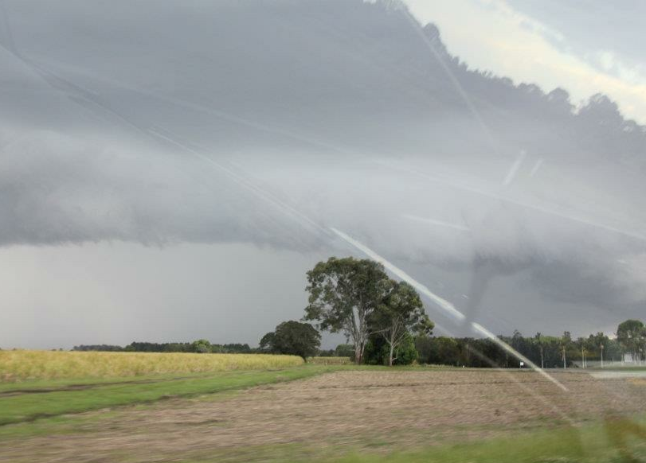
Climate change
Notes:
Climate change has a large and varied impact on our planet. What may feel like a very slight increase in temperature for us has a large impact on the environment.
The current recorded global temperature increase since pre-industrial times is 0.7ºC. Although this may seem like a very small increase, it has resulted in some dramatic outcomes including widespread coral bleaching, an increase in average global sea levels, the skew of sex ratios in temperature dependent species (e.g. logger head turtles, whose eggs are temperature dependent. The sex of turtle offspring are more commonly female due to an increase in temperature), and an increase in extreme and unpredictable storms and weather patterns.
(The four pictured weather patterns are: Top Left- Drought in South Africa/Botswana/Zimbabwe border and the very dry Limpopo River, Top Right- Blizzard in the Australian Alps from an East coast low weather event fuelled by warmer water, Bottom Left- Coral Bleaching off Mission Beach Great Barrier Reef Marine Park, Bottom Right- Water spout in a super cell thunderstorm north of Grafton NSW.

Slide 12
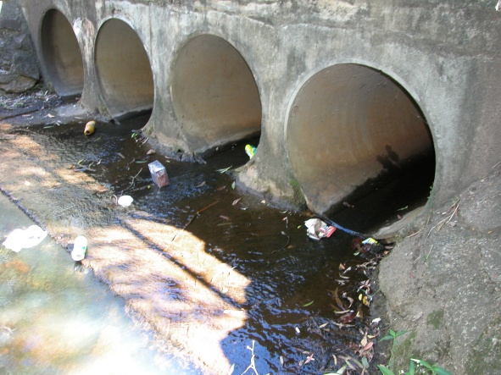
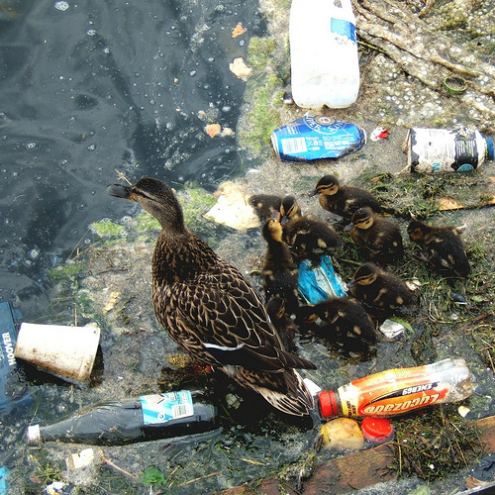
Plastic Litter
Notes:
Plastic bottles are one of the most commonly littered items. As plastics don’t breakdown in the environment, they break up into smaller and smaller pieces. This means they have the potential to cause detrimental impacts to a range of different environments. Eventually, this plastic litter will end up in the ocean

Slide 13
The Great Pacific Garbage Patch
Notes:
The Great Pacific Garbage Patch is a collection of marine debris (litter floating in the ocean) in the North Pacific Ocean . The patch is large (1.6 million square kilometres) – about twice the size of NSW. The patch is comprised mostly of micro-plastics. Micro-plastics are very small pieces of plastic (sometimes not even able to be seen by the naked eye) which occur as larger plastic items (e.g. plastic bottles and containers) break up.
Micro-plastics are easily ingested by small marine animals. As we move up the food chain, and these small marine animals are eaten by larger marine animals, the amount of micro-plastics being ingested by each animal increases. This includes the seafood we eat and means that each time we consume seafood we are than likely consuming micro-plastics.
It is estimated that by the year 2050 there will be more plastic then fish in our oceans
Watch Journey to the Ocean via Rubbish by Grace Kim https://www.youtube.com/watch?v=vh6MDuxYing. Grace, is a student from St. Philips College in Port Stephens created this film for a school project after learning about this growing problem and also learning that Take 3 were trying to educate the broader community.
Ask students to brainstorm other impacts of plastics in our oceans to either our community or the environment
Ask students to suggest where all the plastic in our oceans is coming from? How is it getting there? What can we do to reduce the amount of plastic travelling to our oceans? Much of the plastic in our oceans is as a result of littering.

Slide 14
The Waste Hierarchy- making better choices
Most preferred
AVOID
Ask yourself, do I really need it?
REDUCE
Aim to reduce the amount you buy or use.
REUSE
Check: Can this item be used again?
RECYCLE
Check: Can what I’m throwing away be recycled?
DISPOSE
Dispose to landfill only if there is no alternative.
Least preferred
Notes:
The Waste Hierarchy is the internationally recognised framework for prioritising waste and resource management practices. Since all waste management options have some impact on the environment, the only way to avoid impact is not to produce waste in the first place. This is why waste avoidance and reduction are considered the most preferable options in the hierarchy. Reuse, followed by recycling, while disposal to landfill is considered the least preferable waste management option and is listed at the bottom of the hierarchy.
Avoid – don’t buy new products which are not needed. For example, plastic water bottles. Buying these items can be avoided by owning a reusable water bottle.
Reduce – reduce the amount of waste you buy. For example, buy one box of your favourite snack instead of 12 little packets that become waste and even worse … litter.
Reuse – the use of potential waste to create new items. For example, creating bags (or other new products) from old clothing, giving old clothing to ‘op shops’, making arts and crafts items from old food containers.
Recycle – using council managed recycling systems to recycle waste into new products, therefore reducing the need for natural resources to create new products.
Dispose – The least preferable option, where waste is disposed of to landfill after being used and the resources are lost.

Slide 15
Plastic Recycling
Notes:
Have the students brainstorm which items they can recycle. What happens when they recycle a product? When an item is placed in the yellow topped recycling bin it is transported to a Materials Recovery Facility (MRF) where all the products are sorted based on the materials they are composed of. Plastic bottles, for example, are sorted depending on the type of plastic they are comprised of. The plastic is then shredded, washed and melted. The melted plastic is set in a small mould to be transported to another factory where it is shaped into a new product, refilled, ready to be transported to stores for sale. Ask the students to discuss the benefits of recycling plastic materials
Get students to discuss the benefits of recycling other materials.

Slide 16
Pledge of Commitment
Make a Pledge of Commitment that your class will honour for the year. You could…
Remove all packets and gladwrap from our lunch boxes and pack our lunch in reusable containers instead.
Tell students in other classrooms how they can reduce lunch box rubbish.
Bring reusable drink bottles full of water to school every day.
Pick up litter around the school.
Always use both sides of our paper.

