Slide 1
Litter and the Environment
Lesson 3
NetWaste Teacher Resource for primary schools

Slide 2
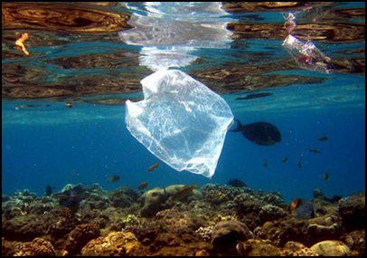
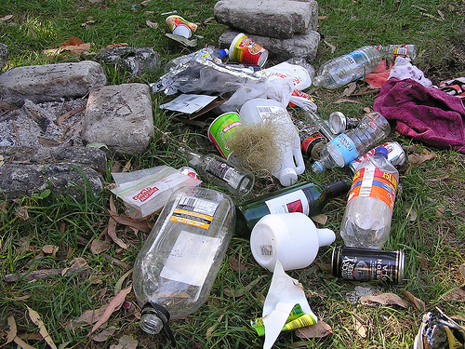
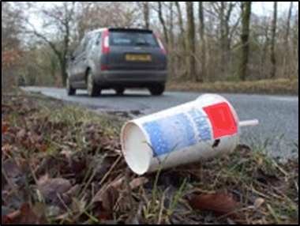
What is litter?
Litter is any material that is dropped or discarded either directly
or indirectly into the environment
Notes:
Litter and illegal dumping are the most visible indicators of pollution in our environment.
In NSW, litter costs at least 180 million every year to clean up.
- Direct littering: items that were intentionally wrongly discarded
- Indirect littering: items that were spread by natural systems including animals and weather patterns

Slide 3
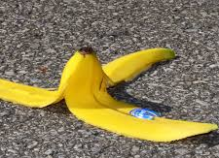
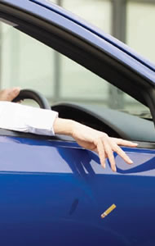
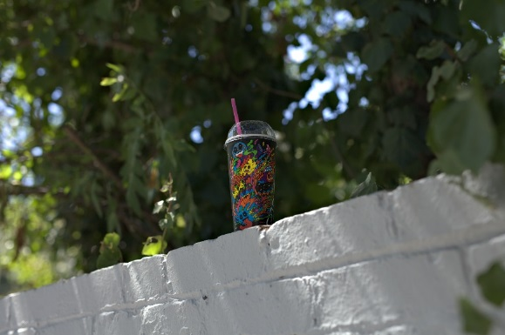
Common litter items
Cigarette butts
Fast food packaging
Plastic bags
Plastic packaging e.g. lolly wrappers, chip packets
Paper products e.g. advertising material and dockets
Plastic drink bottles
Food remains
Notes:
Ask students to brainstorm common litter items, and where these are most commonly found.

Slide 4
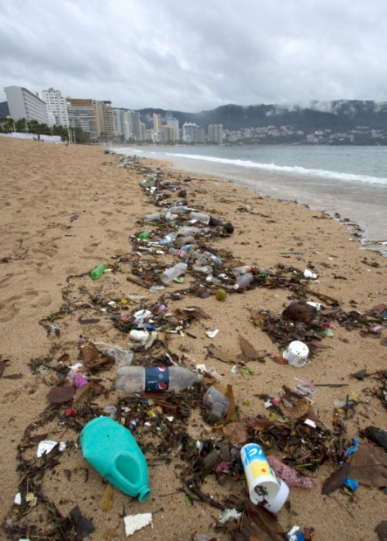
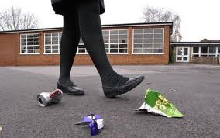
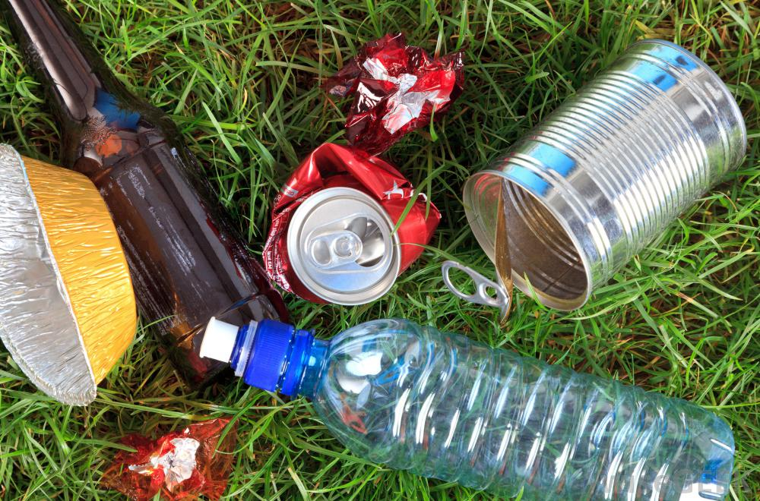
Where can litter be found?
Notes:
Litter is not restricted to one environment type but can be present in all environments, from footpaths, roads, train stations, beaches, parks, waterways, natural areas and vacant blocks. Litter does not stay in one place but can be moved by birds, other animals, and weather patterns such as wind and rain
Ask students to identify areas in the school or the area where they live where litter is an issue. How does the litter they commonly find make them feel?

Slide 5
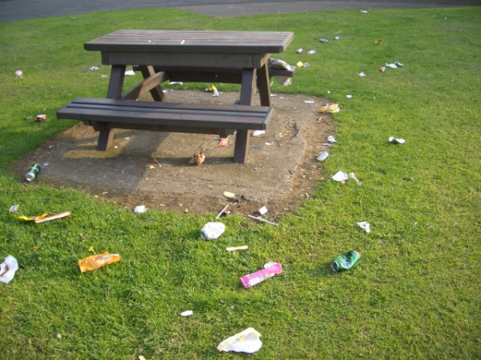
How long does litter last?
It takes just a second or two to drop litter.
What people don’t think about is how long this litter can remain in the environment before it decomposes (breaks down).
Do you know how long litter can
last in the environment?
Notes:
Although it takes only one or two seconds to litter, litter can remain in the environment for a very long time before it decomposes (breaks down).

Slide 6
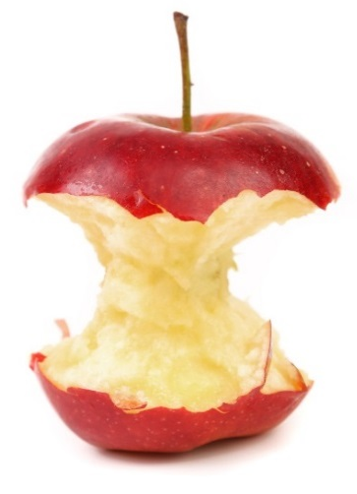
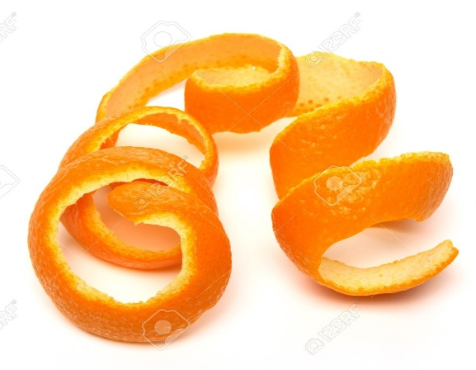
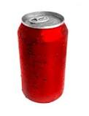
Can you guess how long it would take these litter items to break down?
Paper bags
Apple core
Cardboard
Orange peel
Cigarette butts
Plastic bags
Aluminum cans
Plastic bottles or containers
Glass bottles and jars
Notes:
Ask the students to guess how long it would take each of the littered items to breakdown (decompose) in the environment. Write their guesses on the whiteboard (answers on the next slide)

Slide 7
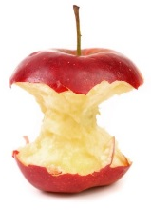
How many did you get right?
Littered items | Approximate time to breakdown
Paper bags | 1 month
Apple core | 1 – 2 months
Cardboard | 2 months
Orange peel | Up to 2 years
Cigarette butts | Up to 10 years
Plastic bags | Never it just breaks up into smaller pieces
Aluminium cans | Up to 500 years
Plastic bottles or containers | Never it just breaks up into smaller pieces
Glass bottles and jars | Millions of years

Slide 8
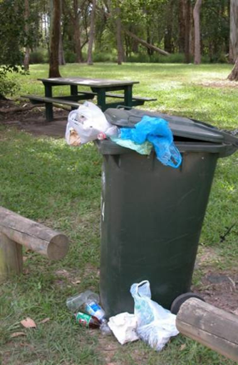
Why do people litter?
No bins
Bins are full
Bins are dirty or smelly
Already litter in the area
Lazy
Did not realise the item was litter e.g. apple cores
Notes:
Why do people litter and how can their behaviour be changed?
- No bins: Waste can be taken home/ to an area where bins exist.
- Available bins are full: Waste can be taken home/ to other bins. Leaving waste on the ground near the bin, or overflowing from the bins is still considered littering.
- Available bins are dirty or smelly: If you do not feel comfortable using the available bins ask a parent or guardian to help you. Otherwise, waste can be taken home or to other bins.
- Litter can already be seen in the area: Litter already visible in the area does not mean it is okay to add more litter. By properly disposing of their waste students are demonstrating the correct behaviour and may help to educate others in the community.
- People are lazy: Considering the impacts of littering can help to change the actions of those who may commonly litter.
- Lack of education – people didn’t realise their behaviour was littering: Students can help to educate their friends and family to ensure they are aware of the impact of littering, and how long it takes for pieces of waste to decompose.

Slide 9
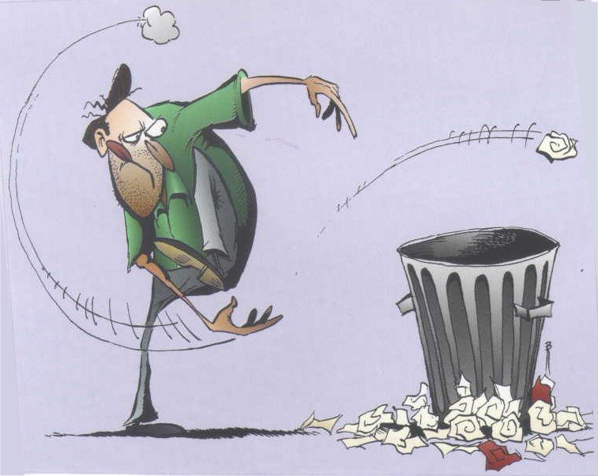
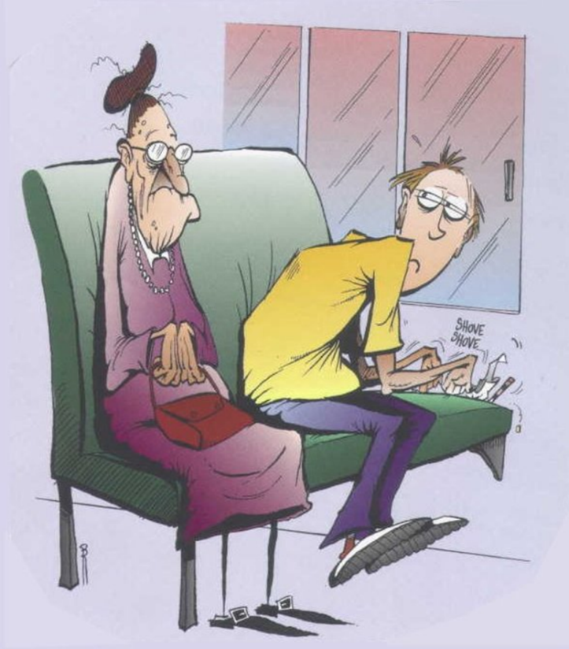
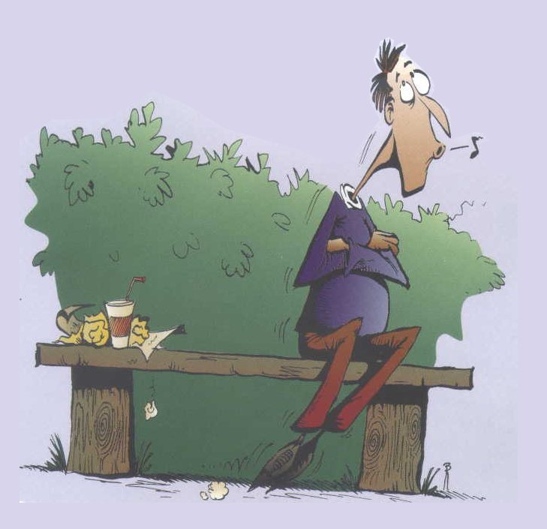
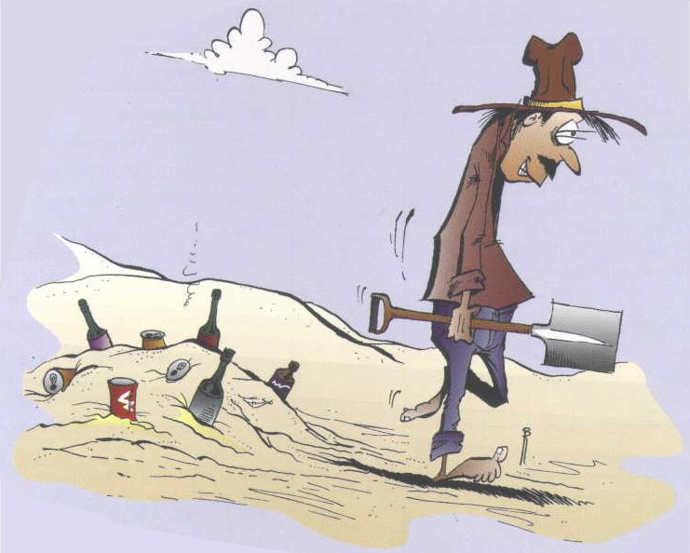
Do you recognize any of these littering behaviours?
Foul Shooters
Inchers
Wedgers
Undertakers
Notes:
Ask students to consider how people litter? Do they often see people littering? Where do people often litter?
Who litters the most?
- Boys or girls? Boys and girls both litter the same amount.
- Older or younger people? Both litter, but older people tend to litter when no-one is watching
Common littering behaviours include;
- Wedgers – those who press their waste into small gaps (e.g. in tables and beside chairs).
- Foul shooters – those who throw their rubbish towards a bin and miss, leaving the waste on the ground close to the bin
- Inchers – those who very slowly move away from their waste until it appears that it doesn’t belong to them, and
- Undertakers – those who bury their waste underground, e.g. those who bury their waste under the sand when at the beach.

Slide 10
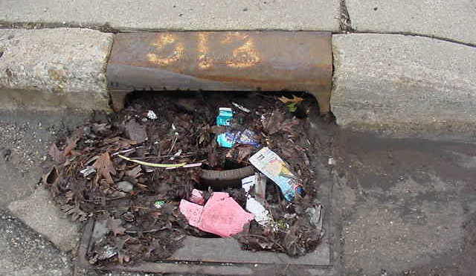
Effects of litter
Litter is bad for the environment
Litter attracts litter
Litter can block drains and cause flooding
Litter can be dangerous
Litter can be a fire hazard
Litter is expensive
Notes:
Ask students to discuss the environmental and social impacts of litter. Which animals in particular do they think littering might impact?
- Litter is dangerous for the environment and can endanger numerous animals before it properly decomposes
- Litter attracts litter. An area in which litter already exists can tempt people to be lazy and leave their litter there also.
- Litter can block drains and cause flooding – litter naturally flows towards rain water drains during rain events. Large volumes of litter in these systems can cause blockages and flash flooding.
- Litter can be a fire hazard – cigarette buds and pieces of glass which are left as litter can easily cause fires.
- Litter is expensive – local governments employ whole teams to street cleaners to try to remove litter before it harms our communities or environment.

Slide 11
Story: The Journey of Litter
Lionel Litterbug had finished his lunch.
He found a bin, but the bin was full.
So he dropped his plastic bag on the ground next to the bin.
Notes:
Introduce the students to Lionel the Litterbug.
Lionel the Litterbug ate his lunch in his local park. At the end of his lunch he went to put his rubbish in the local bin. When he got to the bin he realised it was full and his rubbish wouldn’t fit inside. Lionel thought that if he put his rubbish beside the bin, it would be collected and wouldn’t cause any litter. So, Lionel dropped his plastic bag full of rubbish on the ground next to the bin and left.
Did Lionel litter? What could Lionel have done with his rubbish instead, so as to not litter?

Slide 12
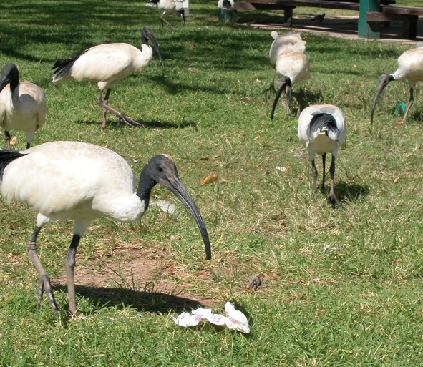
Notes:
Soon after Lionel left the park a group of Ibis found the bag of rubbish next to the big. Curious about what was inside, one Ibis removed all items from the bag.

Slide 13
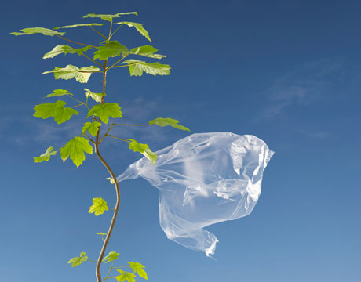
Notes:
After the Ibis left a light breeze swept through the park and picked up the now empty and light bag. The bag was carried away from the park and into the surrounding environment.

Slide 14
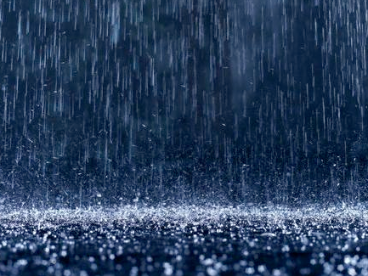
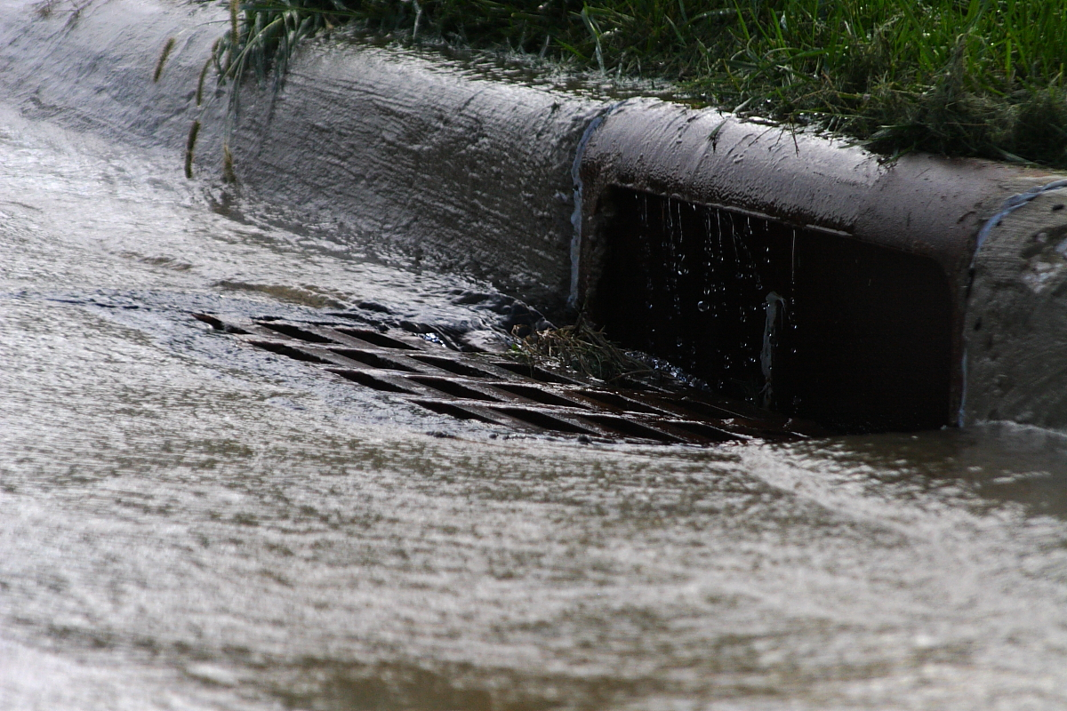
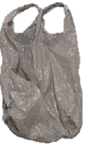
Notes:
That afternoon it begins to rain. The rain carries the plastic bag further away from the park and into the storm water drains.

Slide 15
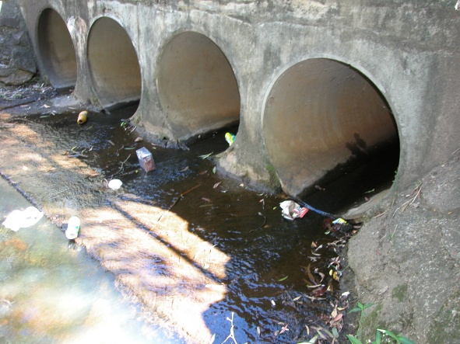
Notes:
The plastic bag travelled through the storm water drains, along with other pieces of litter…

Slide 16
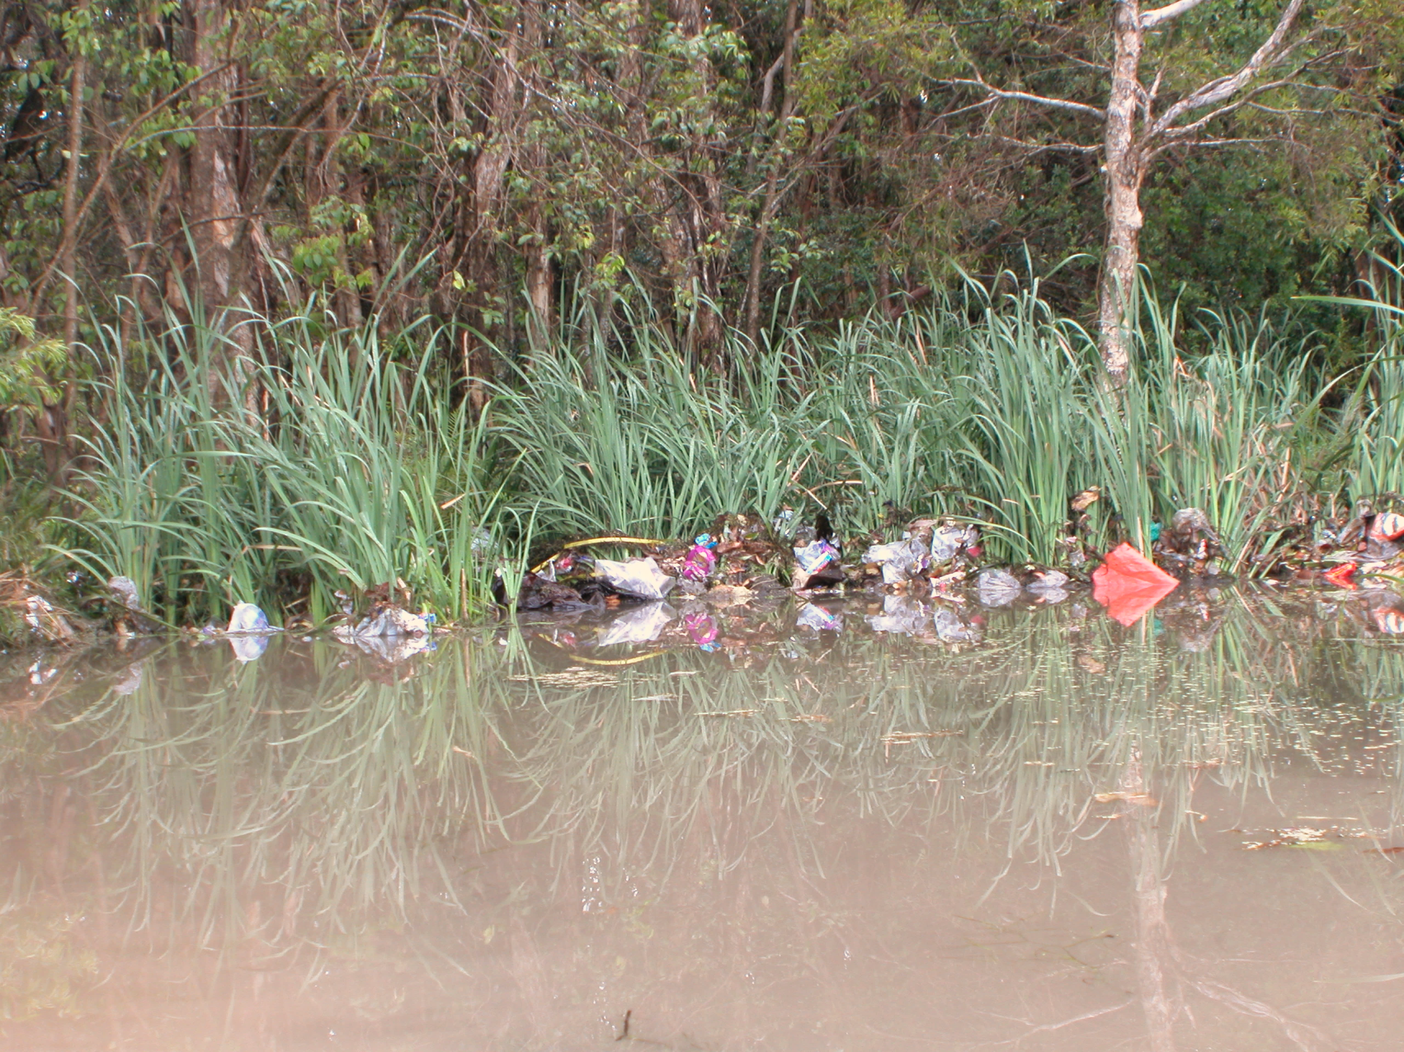
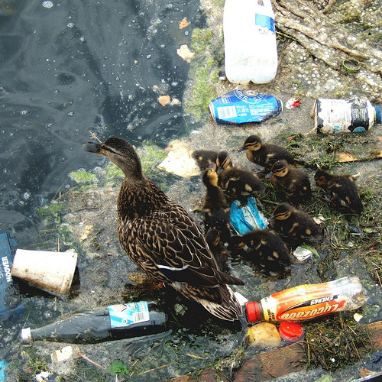
Notes:
Until it made its way into the local creek system. A small family of ducks live in the creek system.
Questions for students:
Does the creek look good with so much litter? Do you think it is healthy for the ducks to live with so much litter? Would they like to have so much litter around their habitat?

Slide 17
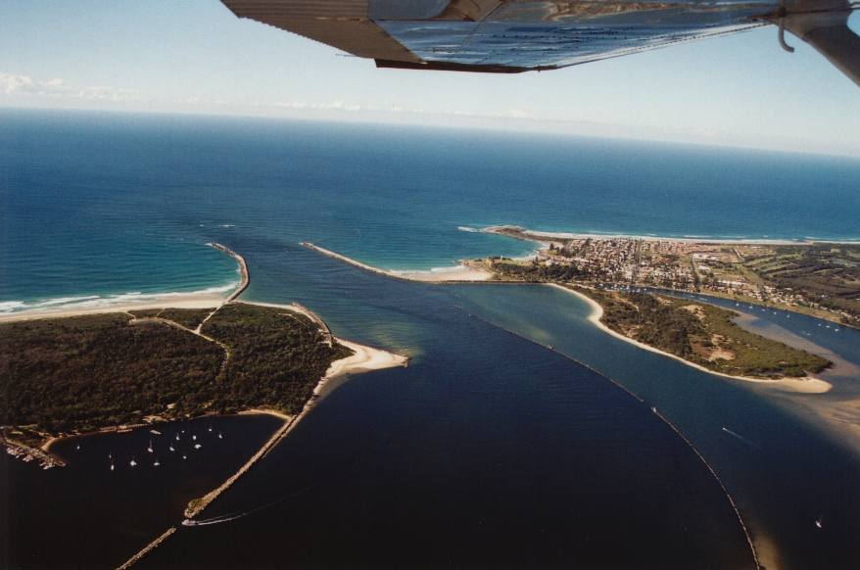
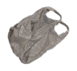
Notes:
The bag continues its journey further downstream until it makes its way to the river mouth. From here the plastic bag is carried out into the ocean.

Slide 18
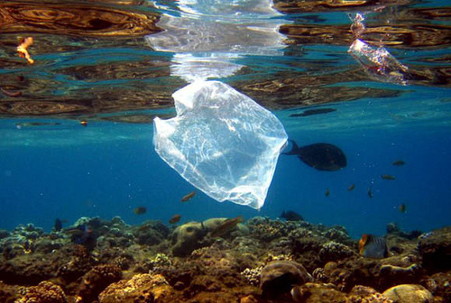
Notes:
As plastic bags take a very long time to decompose the plastic bag is left to float around the ocean on many currents, impacting many animals.

Slide 19
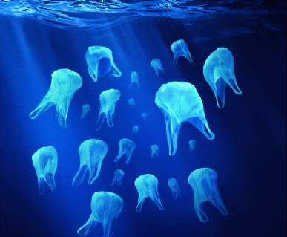
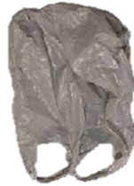
Notes:
Plastic bags look a lot like a common marine animal when they are floating in the ocean.
What animal does the plastic bag remind the students of as it is floating in the ocean? (Plastic bags often look like Jelly Fish while in the ocean)

Slide 20
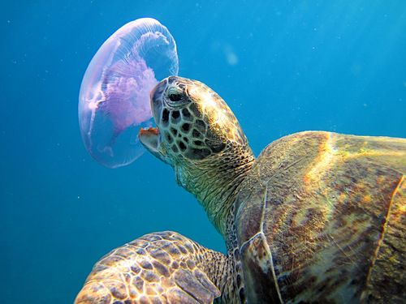
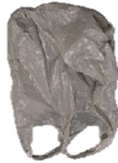
Notes:
One of the turtle’s favourite foods is Jelly Fish. Unfortunately, Turtles are not good at telling the difference between plastic bags and jelly fish, and commonly eat plastic bags by mistake.

Slide 21
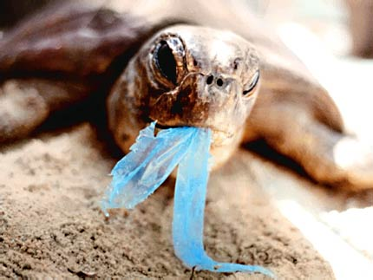
Notes:
Plastic can make animals, including turtles, very sick.

Slide 22
Do you think Lionel Litterbug knew what would happen to his plastic bag when he dropped it beside the bin?
Notes:
Did Lionel litterbug mean for his plastic bag to end up being eaten by a turtle?
What could he have done instead to prevent his rubbish from becoming litter? He could have found a different bin that wasn’t full or taken it home

Slide 23
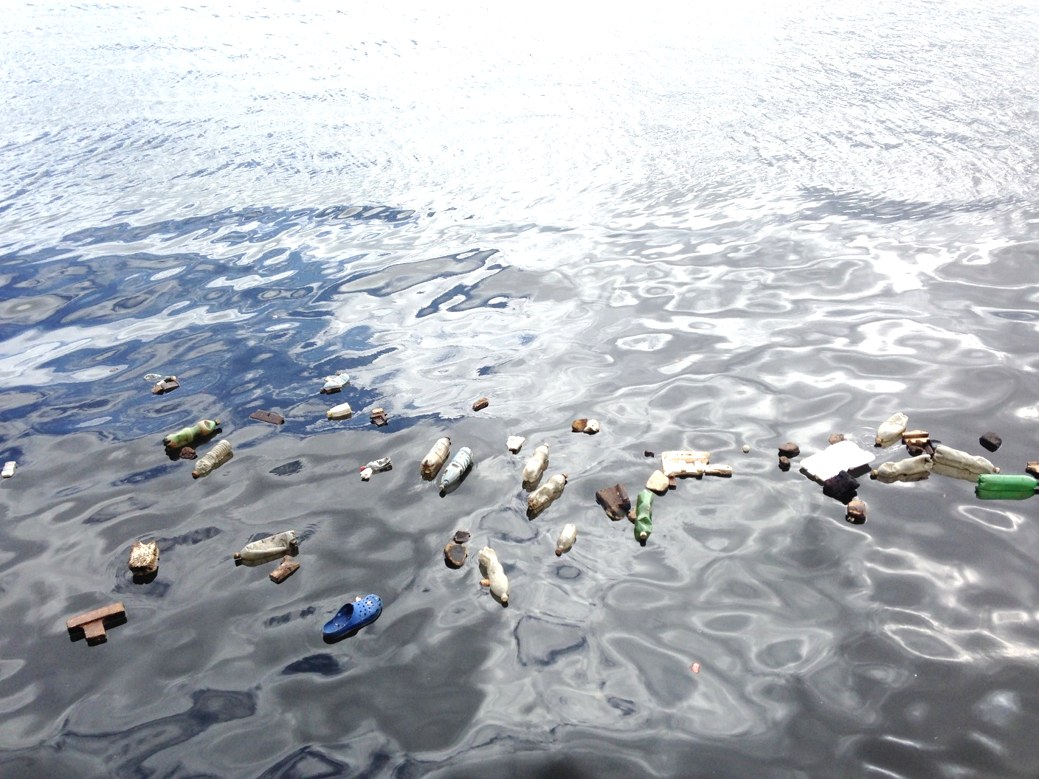
Why is there so much plastic?
Current plastic production is around 300 million tonnes per year, by 2050 it is expected to grow to almost 1 billion tonnes per year.
Plastic never completely breaks down so, once it is created, it remains in our environment forever.
It is predicted there will be more plastic in the ocean than fish by 2050.

Slide 24
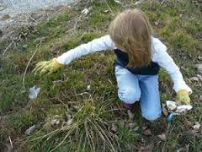
What can you do to prevent litter?
Notes:
Discuss some of the actions that can be taken to minimise and prevent litter such as always putting litter in a bin or taking it home, or joining a litter Clean up activity such as Clean Up Australia Day.

Slide 25
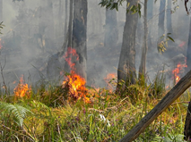
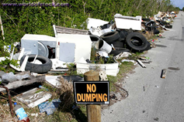
Fines for littering
General littering= $250
Dangerous littering= $450
Illegal dumping= $4000 - $7500
Notes:
Explain to students that people who are caught littering can be fined and, in serious cases, some litterers can face court.

Slide 26
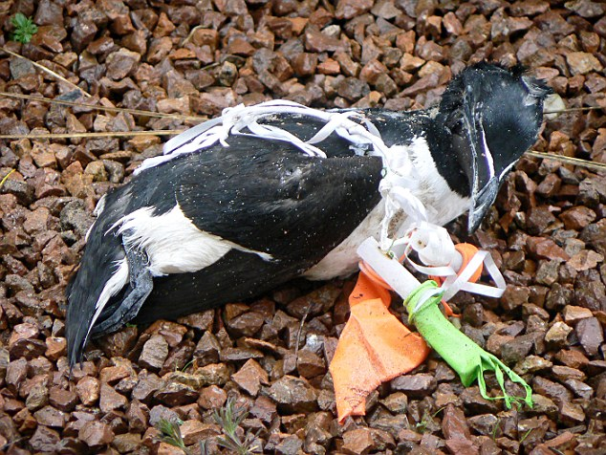
We all have a choice…
Notes:
Ask students to describe how litter makes them feel? (following three slides for prompts) Do they like it when they can see litter in an area they visit? Discuss litter at your school. Is litter at your school a problem? Do you wish there was less litter at your school? Where at your school is litter most commonly seen?

Slide 27
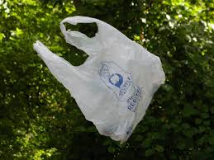
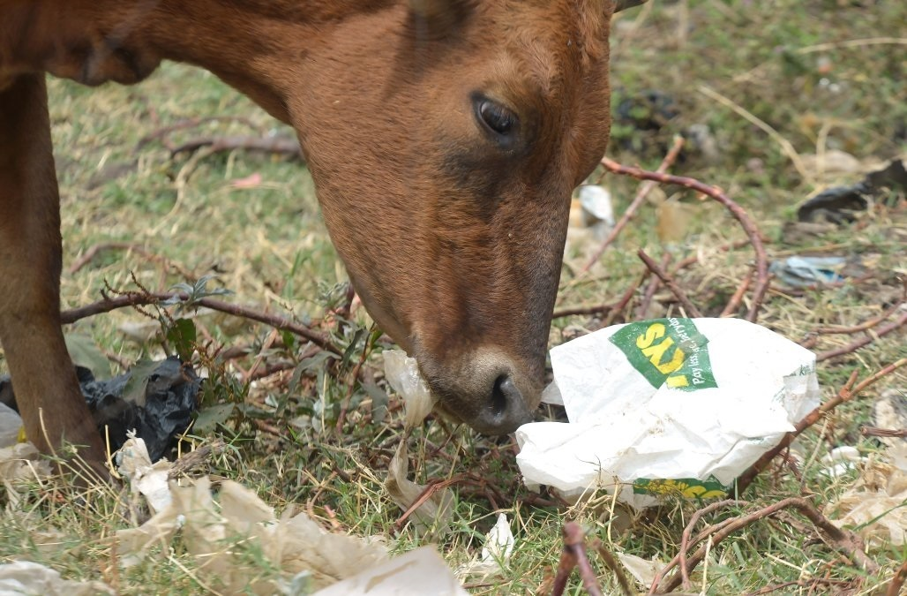
We all have a choice…
Notes:
Ask students to describe how litter makes them feel? Do they like it when they can see litter in an area they visit? Discuss litter at your school. Is litter at your school a problem? Do you wish there was less litter at your school? Where at your school is litter most commonly seen?

Slide 28
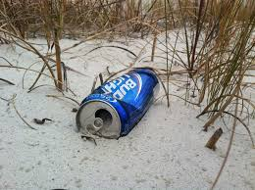
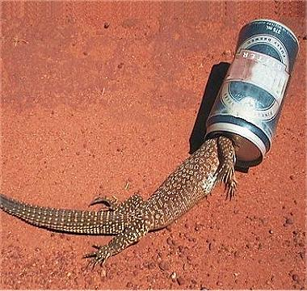
We all have a choice…

Slide 29
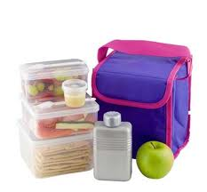
What can I do?
Always use the school bins
Put my litter back in my bag & take it home
Pick up lunchbox litter that is on the ground
Tell people not to litter if I see them drop litter
Pack a ‘litter-free’ lunch
Notes:
Ask students to brainstorm how to pack their school lunch to reduce waste and litter. Introduce the terms “low waste”, “litter-less lunch” and “nude food”. Examples include:
Use reusable containers when packing lunch
Take “nude food” such as fruit that does not require wrapping
Pack a reusable drink bottle
If they pick up any litter they should use gloves or remember to wash their hands afterwards.

Slide 30
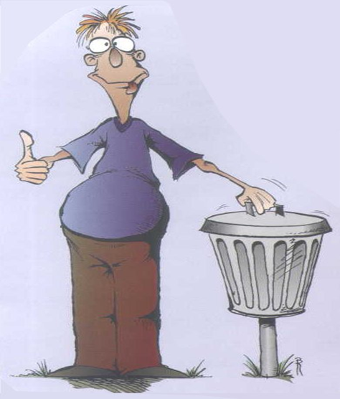
In summary
Litter takes a long time to decompose.
Litter can have devastating impacts on our environment and wildlife.
Litter moves, it does not stay in one place.
People litter for a number of reasons.
People of all ages litter.
There is no excuse for littering.

Slide 31
Pledge of Commitment
Make a Pledge of Commitment that your class will honour for the year. You could…
Reduce packets and gladwrap in our lunch boxes by packing our lunch in reusable containers instead
Bring reusable drink bottles full of water to school every day
Always put our rubbish in the bin
Tell students in other classrooms how they can reduce litter at school
Those who don’t use bottles use water taps

