Slide 1
Nature’s Recyclers: Composting & Worm Farming
Lesson 2
NetWaste Teacher Resource for primary schools

Slide 2
Food, glorious food!
Food is important, and we all need to eat. The fact is that a lot of the food we buy, ends up in the bin!
Source: http://www.foodwise.com.au/
Notes:
Australians are one of the top ten produces of household waste per person in the world
On average, an Australian individual will created more than half a tonne (500kg) of household waste each year.
An average Australian household discards up to 20% of the food purchased, which equates to 1 out of every 5 bags of groceries
An average Australian family sends approximately $700 worth of food to landfill every year.

Slide 3
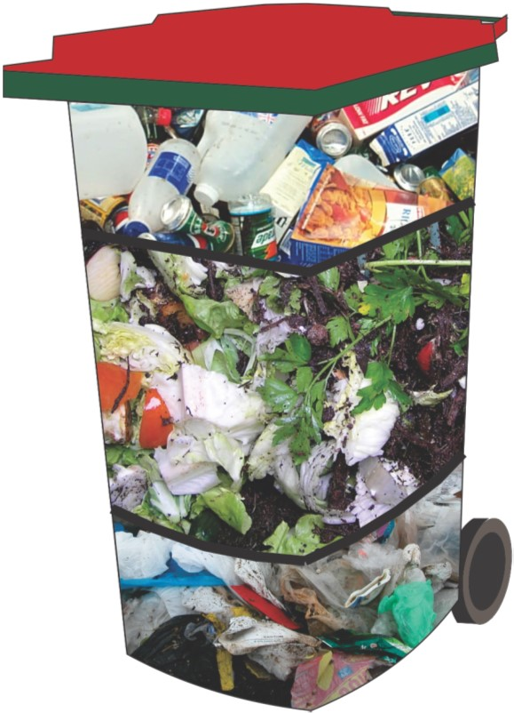
What do we throw away each week?
Each week, the average Australian household’s general waste bin contains:
Approximately 25% of materials suitable for recycling
Over 50% food waste and garden waste - this is known as organic waste
Approximately 25% of general waste materials
Notes:
On average, our household kerbside general waste bins contain between 40% to 50% organic waste (food waste and garden waste). When organic materials decompose in landfill, they release a greenhouse gas called methane, a gas 25 times more potent than carbon dioxide. In addition, when these organic materials combine with rainwater, they produce a nutrient-rich liquid pollutant called leachate.

Slide 4
What is organic waste?
Organic materials are materials that are (or used to be) alive, whereas non-organic materials are non-living materials.
Some examples of organic and non organic waste materials are given in the table below.
Can you think of some others?
Organic waste materials
Apple core
Dead leaves
Watermelon skin
Grass clippings
Non-organic waste materials
Milk bottle
Plastic bag
Baked bean can
Lolly wrapper

Slide 5
Where does the rubbish go?
Rubbish from your general waste bin gets taken to a LANDFILL
At the landfill, large machines such as dozers and compactors drive over the rubbish to compact it (squash it down), before burying it under soil
This means that more rubbish can be added on top.
What do you think happens to all this rubbish?
Notes:
What is a landfill?
All of the rubbish placed in your general waste bin is taken to landfill and will never be recovered or recycled. Recyclable or compostable materials put in this bin will become wasted resources and lost forever.
At the landfill, waste is deposited into a landfill cell. This specifically designed cell is dug down into the earth and lined with synthetic materials and clay. Rubbish is added daily and compacted with the use of dozers and compactors, to compress the rubbish and remove any air space between the rubbish. The more that can be compacted into a landfill, the longer the landfill will take to fill.

Slide 6
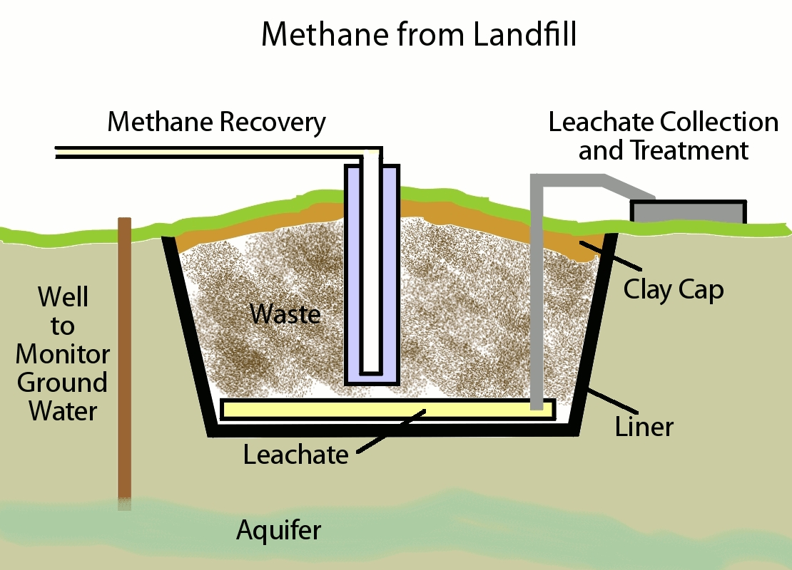
What happens to organic waste at landfill?
When large quantities of organic waste break down (decomposes) in landfill it can create a gas called METHANE
Methane is a GREENHOUSE GAS that can cause damage to the environment if it is allowed to escape
When the rotting organic waste mixes with rainwater, this creates a liquid called LEACHATE
Leachate is a POLLUTANT and must be carefully managed to ensure it does not escape into waterways
Landfills are carefully managed to protect the environment
Notes:
Organic waste is ‘natural’ and decomposes in landfill, however the large volumes of organic waste (sometimes referred to as putrescible waste) presents a number of environmental issues.
At landfills, organic waste decomposes under anaerobic conditions and produces the gas, methane. Methane is a greenhouse gas approx. 24 times more effective at trapping heat in the atmosphere than CO2 →global warming. At some landfills, the methane can be captured and extracted from the site to be turned into electricity.
When rainfall percolates through the layers of a landfill it collects nutrients and other impurities from the buried wastes- this liquid is called leachate If leachate is not contained or pumped out of a landfill and treated, it can pollute groundwater supplies and waterways. Modern day landfills are very carefully planned, managed and monitored to prevent this from happening. Leachate is collected through pipes near the base of the cell. Each cell is lined with several protective layers and sloped so all of the leachate drains to a single point (called the sump), from the base of the sump the liquid is collected and pumped away.
A common use for the liquid is to pump it back into a full cell to help speed up the decomposition of waste. Speeding up the decomposition process results in an accelerated production of methane and subsequent stabilisation of the cell.

Slide 7
Running out of space
FULL
Next landfill
384,400km
(The moon)
Notes:
As populations grow, so do the rates of waste generation. This puts added pressure on landfills.

Slide 8
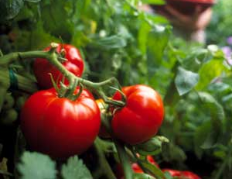
Why recycle organics?
Environmental benefits
Extend the life of landfills
Reduces greenhouse gas emissions
Valuable resource
Free natural fertiliser
Improves soil structure
Improves water retention properties

Slide 9
Closing the loop
Composting or worm farming
Nutrients returned to soil
Organic
waste
Improved plant productivity

Slide 10
What is composting?
Notes:
Composting is nature’s way of recycling as it simply replicates the natural decomposition process. Use example of rainforest floor. Organic materials decompose in an aerobic state (meaning with oxygen) and so should not produce a strong smell and do not release environmental pollutants
Correct management and maintenance of the compost bin accelerates these processes.
Use the analogy of baking a cake. For a successful compost you need the right ingredients in the right quantities for best end results

Slide 11
The ADAM recipe
Aliveness
Diversity
Aeration
Moisture
Notes:
Key to keeping your compost system healthy and trouble shooting.

Slide 12
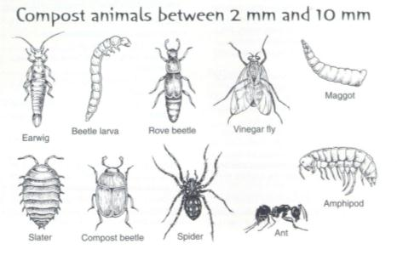
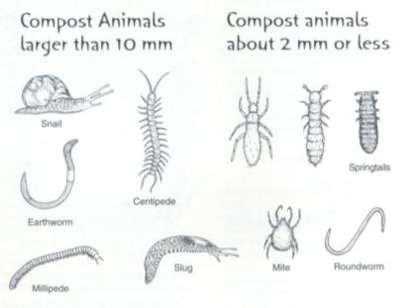
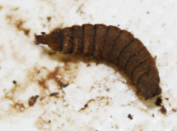
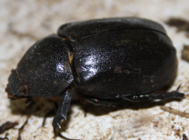
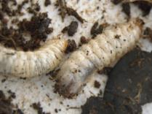
Aliveness
Notes:
It is important to remember that compost bins are alive with millions of microorganisms and small macro-organisms/ invertebrates who are all doing their bit to break down or decompose the organic waste. This is why a static compost bin located on the ground can be more effective than a tumbler compost bin the critters can get in and aid the decomposition process, although the tumbler type also has its benefits in aeration
Bacteria and fungi are the key organisms in the compost system, reproducing at amazing speed and working to decompose materials. Three types of bacteria are found in a compost system and their presence is related to temperature: cool bacteria (psychrophilic), warm bacteria (mesophilic) and hot bacteria (thermophilic). In optimum conditions, bacteria can double their population every 20-30 minutes. Certain bacteria also generate heat which is distinctive feature of a healthy compost. The fungi breakdown the tough, woody ingredients or materials that are too dry, acidic or low in nitrogen for bacteria. There may be in excess of 5000 million threads of fungi (called hyphae) in a compost bin.
In a well functioning compost bin, the numerous organisms are connected through an extensive food web made up of primary, secondary and tertiary consumers.
A compost system must provide the right condition (diversity/ diet, air and moisture) for these ‘engines’ of the composting system to work

Slide 13
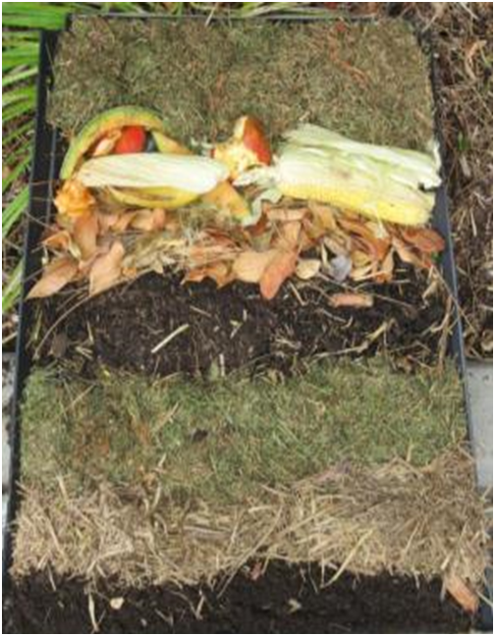
Diversity
Neutralisers: Wood ash, lime, egg shells, dolomite
Other great ingredients: comfrey, yarrow
Notes:
D is for diversity or diet – It is important to have good mix of organic material for your compost bin in order to make compost successfully. Introduce Greens and browns and explain roles of each. Carbon acts as food/fuel and Nitrogen rich material are important for reproduction of microorganisms – more organisms, more heat, faster decomposition!
Go through other useful ingredients – and their roles e.g. wood ash, lime or egg shells help to balance pH levels (reduces acidity) and manure is a good ‘activator’ or Nitrogen bomb that will give compost a boost. Reiterate that only herbivore manure is suitable.

Slide 14
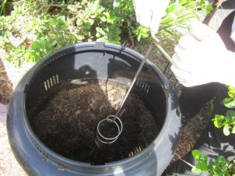
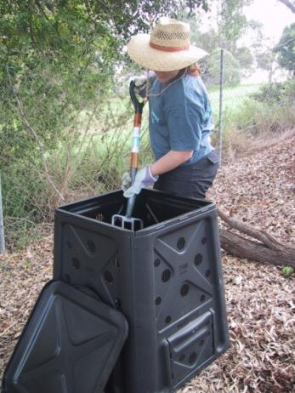
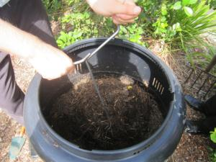
Aeration
Compost Turner
Garden Fork
Notes:
Regularly mixing or turning the compost allows oxygen into the pile, providing good conditions for aerobic decomposition and optimum conditions for the compost organisms. Many compost bins feature vents or pipes that allows air to circulate. Woody materials such as twigs and straw also help to aerate the compost by reducing compaction of materials as the heap decomposes. The balance between air and moisture is critical- compost should be well aerated, but not dry.

Slide 15
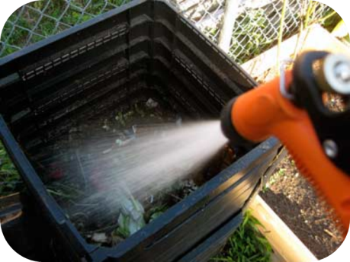
Moisture
Moisture can come from many sources:
Grey water – e.g. from washing up
Cooking water
Hot water bottle
Tea or coffee pot
Flower vase
Your compost should be about as moist as a wrung out sponge
Notes:
Moisture – a healthy compost needs t be kept damp. Too much water and pile compacts and oxygen is removed - Anaerobic bacteria thrive (keep pile similar moisture to a wrung out sponge)

Slide 16
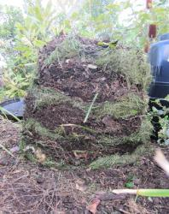
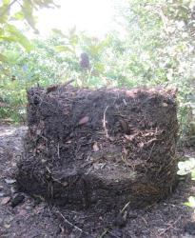
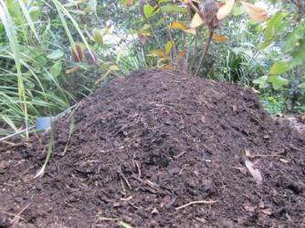
Other important factors
Temperature
Sunny position – compost should reach approx. 60°C
Time it takes to create compost
6-8 weeks – dedicated composter
4-6 months – casual composter

Slide 17
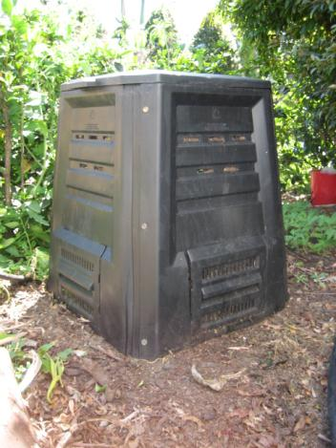
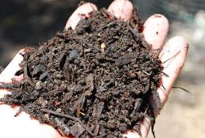
The end product
Notes:
The end product should be dark brown or black, crumbly and have an earthy smell. Compost can be turned into garden beds (to a depth of about ½ a shovel blade) or mixed with potting soil for pot plants or to grown seedlings. Compost is a free, natural fertiliser for the garden that improve soil structure and the water retention capacity of the soil and adds nutrients and beneficial microbes.
Some compost bins have ‘access doors’ at the bottom of the unit, allowing users to access handfuls of the ‘ready’ compost. In some instances , this might be easier than trying to lift off the whole compost bin. This would also be more useful if you do not require a whole bin of compost.
Dedicated composters (& those with available space) can have a number of compost bins going at one time each at different levels of maturation, so a ready supply of compost is always on hand.

Slide 18
Troubleshooting
Turn heap, add water, add manure
SLOW= Not enough air, no active ingredients
SMELLY= Too wet, not enough air, too acidic
Add dry material, turn heap, add dolomite
Cover with soil or any brown material
SMALL FLIES= exposed fruit
Remove breads, grains, meat or dairy products, cover entry with wire, turn heap, moisten
VERMIN= wrong food or warm dry nest
Notes:
Slow – if your compost bin is very slow to produce a finished product it could be a hint that you are not adding enough air or active ingredients to your pile. Fix this problem by regularly turning the compost pile and adding water and manure.
Smelly – compost bins will often begin to smell if they are becoming too wet, do not have enough air or have become too acidic. Reduce smell in your compost bin by adding dry materials, turning your pile to aerate and adding dolomite to reduce acidity.
Small Flies – the presence of small flies in the compost pile probably means there is exposed fruit. To reduce the flies in your compost bin simply cover fruit and vegetables with a small layer of soil or other brown material.
Vermin – Vermin are often attracted to compost piles which contain the incorrect food types (specifically meat, bread and cheese), or that are too dry. To stop vermin from being attracted to your compost remove all breads, grains, meat and dairy products, turn the pile regularly and moisten until the compost pile holds a similar moisture content of that of a damp sponge.

Slide 19
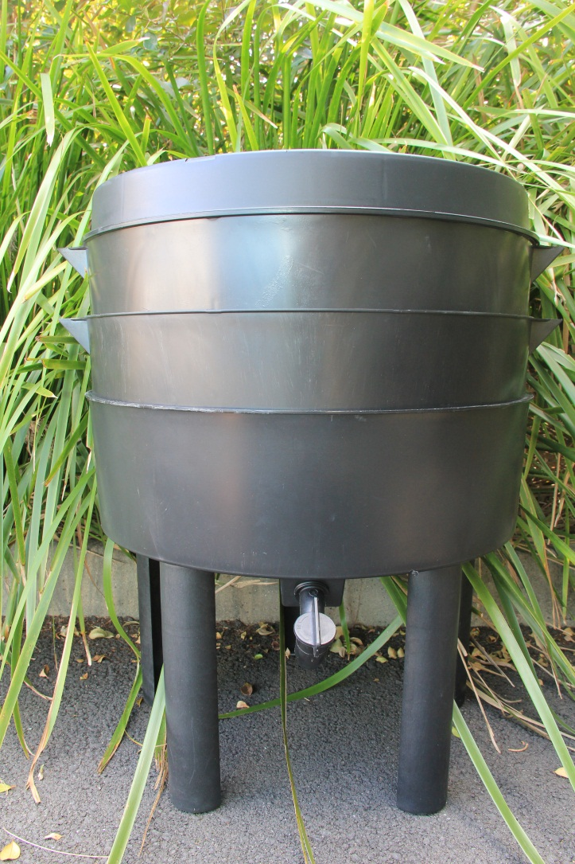
Worm farming
Ideal for homes with small or no yards
Primarily for food scraps
Low maintenance
Faster process than composting
Produce castings and liquid fertiliser

Slide 20
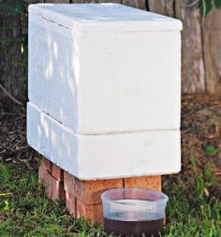
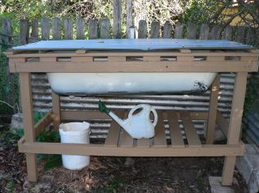
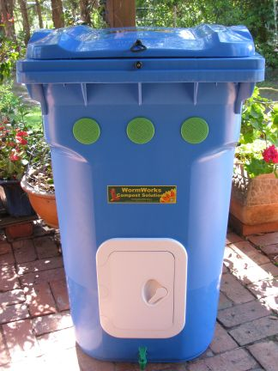
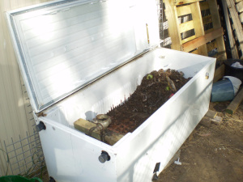
DIY Worm farming
Notes:
Worm farms can be built by reusing materials you may already have at home. Some examples include polystyrene boxes, old bathtubs or a stack of old tyres. Ask the students if they can think of any other materials they might have at home that they could use to make a worm farm.

Slide 21
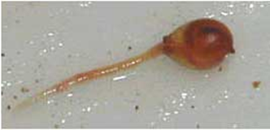
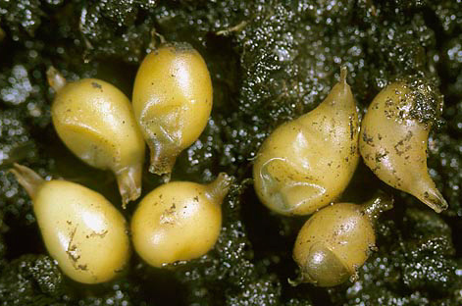
Compost Worm facts
Special compost worms live in a worm farm- not earthworms
Population doubles every 2-3 months
Eat their body weight in 24 hours
Average lifespan of 2-3 years
No teeth, eyes, ears or nose but 5 hearts
Sense vibrations, light and temperature
Breathe through the pores in their skin
Notes:
Take better care of worms when you know a little about them…
Hydrostatic skeleton
Worms hearts are actually aortic arches.
The aortic arches do not have any chambers and circulate blood throughout the body. The arches act as a confluence of dorsal and ventral blood vessels. Due to the pulsating action of the branches, which is similar to the action of hearts, they are referred to as “Hearts” or “Pseudohearts”.
Adult worms feature an enlarged segment, called the clitellum or saddle, which is the site where reproductive activities occur. Although worms are hermaphrodites (they have both male and female organs) most species exchange sperm and eggs. After fertilisation, a cocoon forms a band around the outside of the worm's body, eventually rolling off the worm’s head as it moves. A cocoon may contain up to 20 embryos.

Slide 22
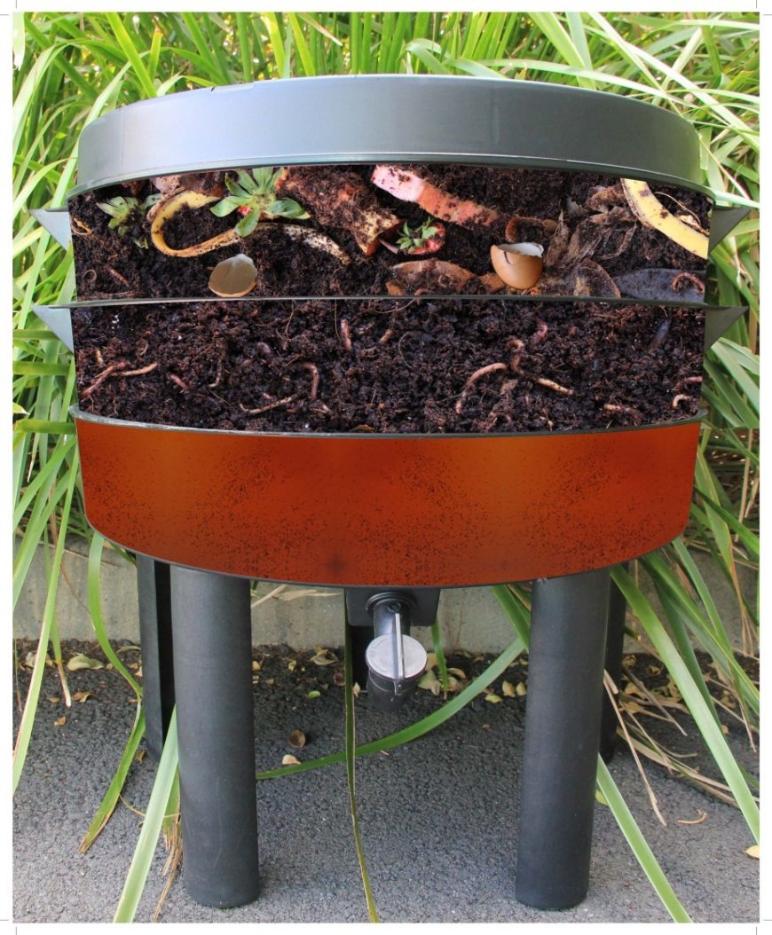
Worm farm set-up
Lid with air vents/ fly screens
Feeding tray
Bedding tray
Liquid collection tray
Tap

Slide 23
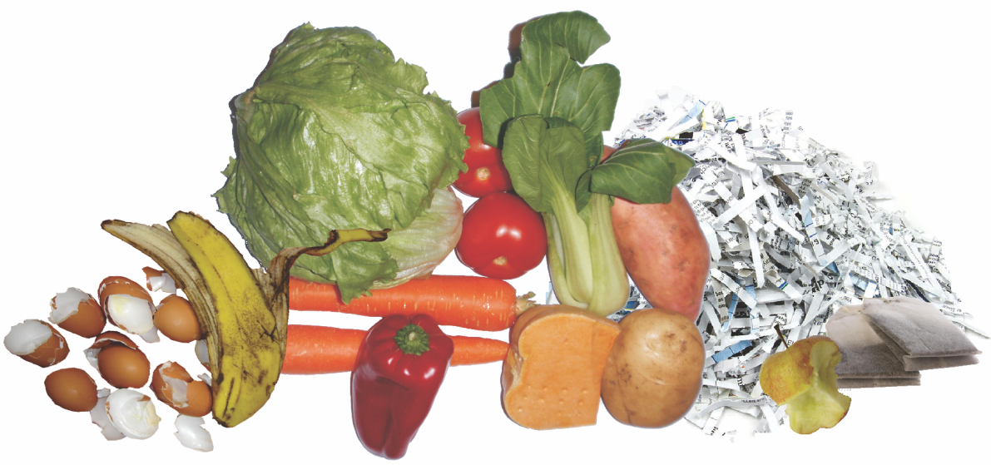
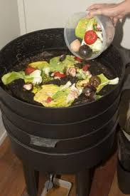
What do worms eat?
Tip: adding garden lime to the worm farm can help to eliminate smells.
Fruit and vegetable scraps
Egg shells
Tea bags/leaves & coffee grounds
Torn up moist paper and cardboard
Notes:
Point out the differences between compost and worm farm diet and the value of cutting/ shredding / processing the worm food as worms have no teeth . This aids faster digestion → faster production of castings, liquid etc.

Slide 24
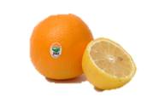
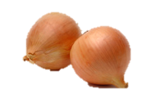
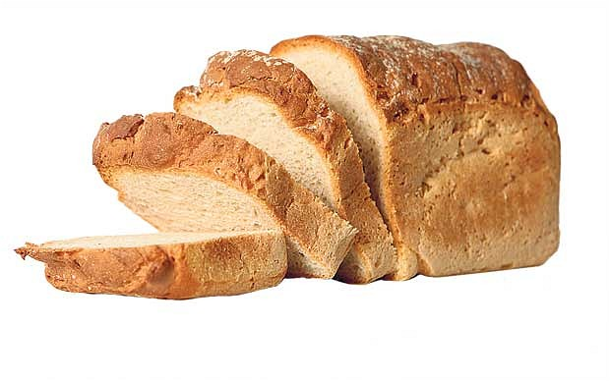
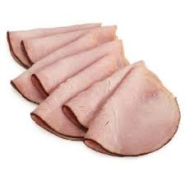
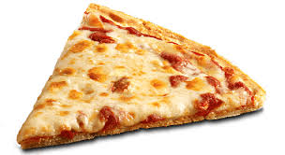
What don’t worms eat?
Citrus peel
Dairy products
Onion and chilli
Bread or pasta
Meat
Grass clippings
Oily or salty food

Slide 25
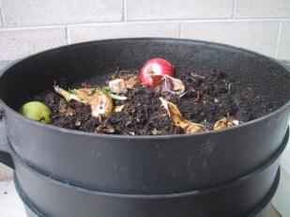
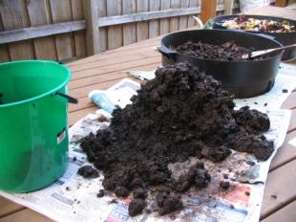
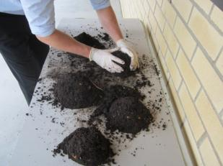
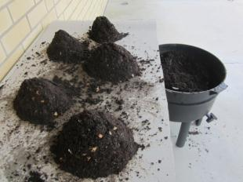
Harvesting worm castings
Notes:
When the Coir in the worm farm disappears and a dark, damp soil material remains it is time to harvest your worm castings! To do this, empty the bedding or kitchen tray (whichever contains the worm castings) onto a table with bright light. Shape the castings into peaked mounds. As the worms travel downwards to escape the light scrape the top layer of castings off the mound. It’s ok to lose a few worms to the garden in this process as compost worms are able to double their population in approximately 2 – 3 months.

Slide 26
Troubleshooting
Fluff castings, add shredded paper. Empty casting from lower trays to improve drainage.
TOO WET: Worms can drown, system lacks oxygen
TOO DRY: Worms will overheat
Cover working layer with wet cardboard or hessian. On hot days, spray working layer with a water mister.
Sprinkle the working layer with dolomite or garden lime, add crushed egg or oyster shells. Improve drainage.
SMALL FLIES: Exposed fruit or excess moisture in farm
Hold off feeding until most of the food in the tray has been eaten. Sprinkle with dolomite or garden lime.
BAD SMELL: Decomposing food scraps
Notes:
Too wet – compost worms need to breath oxygen and if the worm farm becomes too wet they face the risk of downing. Add shredded paper to absorb some moisture and empty castings from the lower trays to improve overall drainage.
Too dry – worms prefer an environment that is damp. To ensure your worm farm has enough moisture cover the kitchen tray with wet cardboard or hessian. On hot days spray this layer with a water mister.
Small flies – small flies are often attracted to exposed fruit or excess moisture within the farm. To remove flies from the farm sprinkle the kitchen layer with dolomite or garden lime. Reduce moisture in the farm by increasing drainage between layers.
Bad smell – a bad smell from the worm farm can often mean the food scraps are decomposing. This is often an indication that you are overfeeding

Slide 27
Pledge of Commitment
Make a Pledge of Commitment that your class will honour for the year. You could…
Establish our own compost bin and worm farm at school or at home
Collect fruit and veggie scraps from our lunchboxes every day to feed to the compost bin or worm farm.
Frequently discuss the types of things we can put into our compost bin or worm farm.
Check on our compost bin or worm farm weekly to ensure it is healthy and functioning.
Frequently discuss the positive impact our class is having on the environment by recycling organic waste.

