Slide 1
Waste and Recycling: Which bin does it go in?
Lesson 1
NetWaste Teacher Resource for primary schools

Slide 2
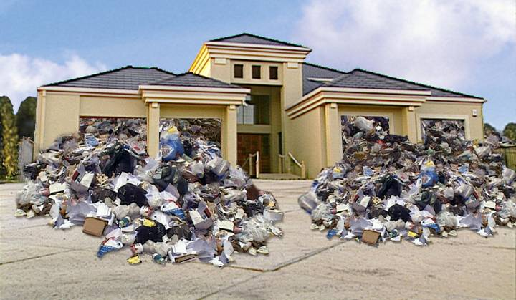
How much rubbish do we produce?
Did you know that the average Australian family creates enough rubbish in just one year to fill a three bedroom house!
Notes:
Australians are one of the top ten produces of household waste per person in the world
On average, an Australian individual will created more than half a tonne (500kg) of household waste each year.
Main rubbish sources:
-Home
-School
-Where else?

Slide 3
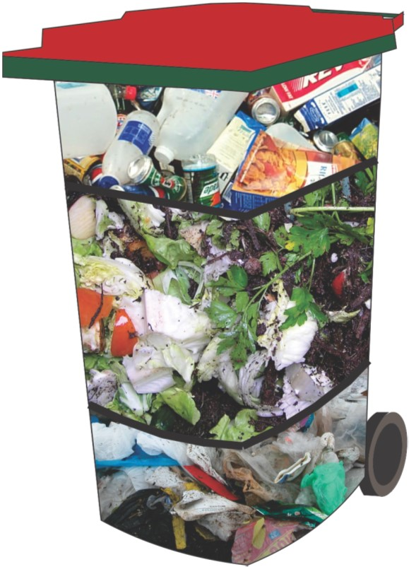
What do we throw away?
Each week, the average Australian household’s general waste bin contains:
Approximately 25% of materials suitable for recycling.
Over 50% food waste and garden waste.
Approximately 25% of general waste materials.
Notes:
How full is your general waste bin at home? What do you put in it?
If we removed food and garden waste from our general waste bin, by implementing the use of organic recyclers, such as compost bins, worm farms, or placing it in a Food and Garden Waste bin if you have one, we could reduce the waste we send to landfill by up to 50%.

Slide 4
Where does the rubbish go?
Rubbish from your general waste bin gets taken to a LANDFILL.
At the landfill, large machines such as dozers and compactors drive over the rubbish to compact it (squash it down), before burying it under soil.
This means that more rubbish can be added on top.
What happens to all the rubbish?
Does it just disappear?
Notes:
What is a landfill?
All of the rubbish placed in your general waste bin is taken to landfill and will never be recovered or recycled. Recyclable or compostable materials put in this bin will become wasted resources and lost forever.
At the landfill, waste is deposited into a landfill cell. This specifically designed cell is dug down into the earth and lined with synthetic materials and clay. Rubbish is added daily and compacted with the use of dozers and compactors, to compress the rubbish and remove any air space between the rubbish. The more that can be compacted into a landfill, the longer the landfill will take to fill.

Slide 5
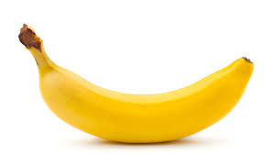
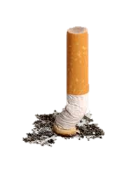
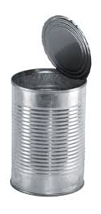
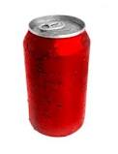
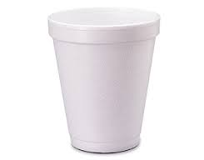
How long does rubbish last in landfill?
Banana → 1 month
Cigarette butts → 12 years
Steel can → 100 years
Aluminum can → 500 years
Plastic bottle → never completely breaks down
Glass → never completely breaks down
Styrofoam cup → never completely breaks down
Notes:
Rubbish does not just disappear once it is taken to landfill, in fact, because it is buried underground. without light or oxygen, it can take many years to breakdown.
When decomposition occurs without oxygen it is called anaerobic decomposition. This is a different decomposition method then that which occurs in most compost bins or worm farms, where aerobic decomposition takes place. The process of anaerobic decomposition leads to the production of methane, a harmful greenhouse gas. Reducing the waste taken to landfill can reduce the amount of methane produced from landfills.
Decomposing waste also creates a pollutant called leachate – leachate is a liquid similar to “bin juice” and collects at the bottom of the landfill.

Slide 6
How does a landfill work?
Groundwater
Compacted clay
Plastic liner
Leachate collection pipe
Geotextile mat
Gravel
Drainage layer
Soil layer
Old cells
New cells
Leachate pond
Notes:
The diagram above demonstrates the layers and development of a landfill cell. Each of the layers described below covers both the bottom and the sides of the cell, restricting the movement of waste into the natural environment.
A – Groundwater – the natural existing water and/or substrate that exists when the hole for the cell is initially dug.
B – Compacted Clay – This clay is highly compacted and used to create and layer with low permeability (liquid is not easily able to travel through this layer). This layer is normally approximately 300mm thick.
C – Plastic Liner – This plastic liner is used to reduce permeability between layers and restrict the movement of liquid pollutants.
D – Leachate Collection Pipe – Leachate is a pollutant similar to “bin juice” and collects at the bottom of the landfill. This liquid would be harmful if it were to leak into the surrounding environment. Leachate is collected in the pipes illustrated in the image and moved to either the Leachate Pond, where the liquid is treated, or pumped back through the waste to quicken decomposition.
E – Geotextile mat – Similar to the plastic liner this layer is very low permeability and restricts the downward and outward movement of liquid waste.
F – Gavel – this layer allows leachate to move downward towards the leachate pipes whist restricting the movement of other waste and materials.
G – Drainage Layer – Similar to the gravel layer, A layer of sand or a thick plastic mesh called a geonet collects leachate and allows it to drain by gravity to the leachate collection pipe system
H – Soil Layer – This layer separates the Leachate Drainage Layers (layers G – D) and the rubbish cells which are placed in the landfill cell. When the landfill is completely empty, this layer would be the layer seen from above.
I – Old Cells – After each day of rubbish being added to the landfill cell a layer of soil is placed into the rubbish once is has been compacted. This soil restricts the ability of animals to access the rubbish, keeps the rubbish compacted and reduces the ability for rubbish odour to travel from the cell.
J – New Cells – This layer is the layer of waste that can be seen during the day, as the landfill cell is being added to. This cell will be covered in soil at the end of the day and become another ‘old cell’ layer.
K – Leachate Pond – Leachate pipes (D) collect leachate from the bottom of the landfill and transfer it to a Leachate Pond, here the leachate is treated before it can be released into the environment as a non-harmful liquid.

Slide 7
Landfills and the environment
Landfills take up valuable space.
Landfills ‘collect’ natural resources that could be used to make new products.
Landfills are expensive to build and maintain.
Materials buried in landfill take a long time to decompose (breakdown).
Landfills produce methane gas - a greenhouse gas.
Decomposing waste combines with rainwater to produce a liquid called leachate which must be removed from the landfill.
Notes:
An increase in population will mean an increase in the production and disposal of waste. As of 2016, Australia’s population was growing at a rate of 1.4% a year. The Australian Bureau of Statistics estimates that one person is born in Australia every 1 minute and 44 seconds (2017)!
As we have no other environmentally safe way to dispose of our waste, landfills are currently necessary. As each landfill cell is filled to maximum capacity, more space is needed to be used to create more landfill sites.

Slide 8
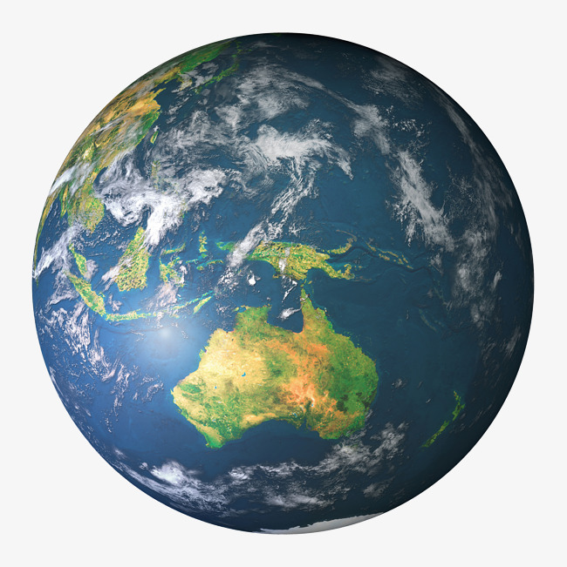
What happens if we run out of landfill space?
FULL
Next landfill
384,400km
(The moon)
Notes:
Brief discussion around what happens when landfills fill up? Where can all the rubbish go? What can we do to reduce rubbish that goes to landfill- introduction of the Waste Hierarchy and the 3 R’s; Reduce, Reuse, Recycle.

Slide 9
The Waste Hierarchy
Most preferred
AVOID
Ask yourself, do I really need it?
REDUCE
Aim to reduce the amount you buy or use.
REUSE
Check: Can this item be used again?
RECYCLE
Check: Can what I’m throwing away be recycled?
DISPOSE
Dispose to landfill only if there is no alternative.
Least preferred
Notes:
The Waste Hierarchy is the internationally recognised framework for prioritising waste and resource management practices. Since all waste management options have some impact on the environment, the only way to avoid impact is not to produce waste in the first place. This is why waste avoidance and reduction are considered the most preferable options in the hierarchy. Reuse, followed by recycling, while disposal to landfill is considered the least preferable waste management option and is listed at the bottom of the hierarchy.
Avoid – don’t buy new products which are not needed. For example, plastic water bottles. Buying these items can be avoided by owning a reusable water bottle.
Reduce – reduce the amount of waste you buy. For example, buy one box of your favourite snack instead of 12 little packets that become waste and even worse … litter.
Reuse – the use of potential waste to create new items. For example, creating bags (or other new products) from old clothing, giving old clothing to ‘op shops’, making arts and crafts items from old food containers.
Recycle – using council managed recycling systems to recycle waste into new products, therefore reducing the need for natural resources to create new products.
Dispose – The least preferable option, where waste is disposed of to landfill after being used and the resources are lost.

Slide 10
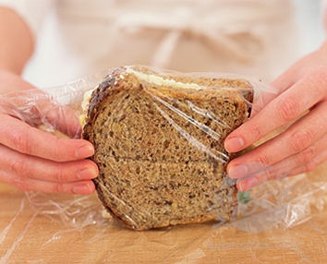
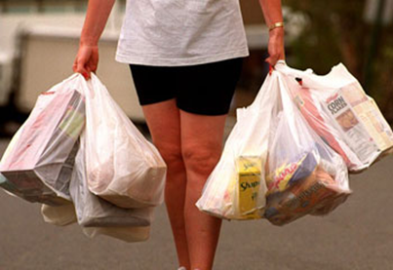
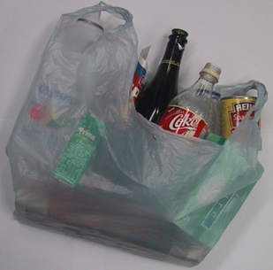
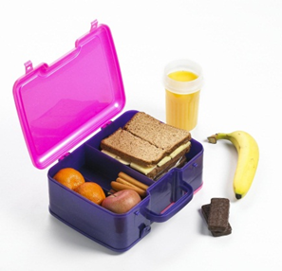
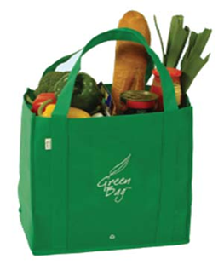
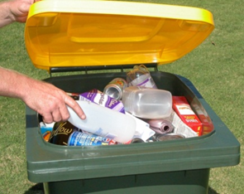
Reduce, Reuse and Recycle
Reduce | Reuse | Recycle
Notes:
Students to brainstorm their own ideas of ways to reduce, reuse and recycle

Slide 11
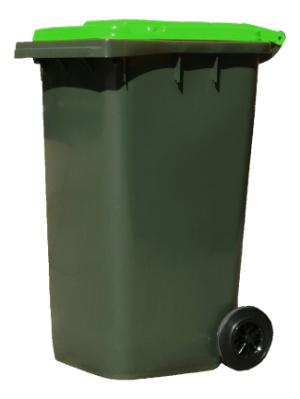
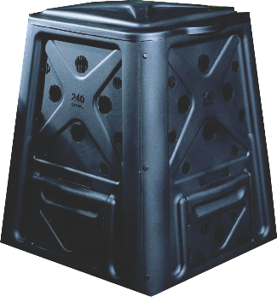
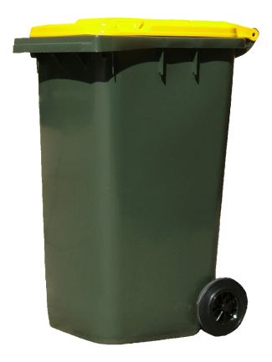
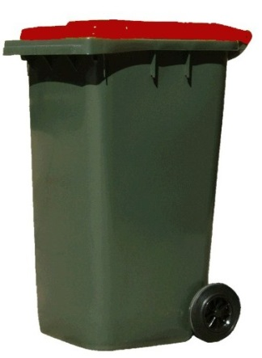
Which bin do you put it in?
REUSE
FOOD & GARDEN WASTE BIN
OR COMPOST BIN
Green is for go!
If it doesn’t grow, it doesn’t go!
RECYCLE
MIXED RECYCLING BIN
Yellow is for slow down and think!
Can what I’m throwing away be collected in our recycle bin?
DISPOSE
GENERAL WASTE BIN
Red is for stop!
Is this a resource I should be rescuing?
Dispose to landfill only if there is no alternative.

Slide 12
What can I recycle in the recycle bin?
Only the following materials can be placed in the yellow lidded recycling bin:
Paper and Cardboard
Aluminum cans (drinks)
Steel cans (food)
Aerosol cans
Glass bottles and jars
Hard plastic containers and bottles
Notes:
Discuss items which are recyclable, and items which cannot be recycled (called contamination when found in the recycling bin).
One difficult item – plastic bags and other soft ‘scrunchy’ plastics. These items cannot be recycled in household recycling bins and can cause damage to the machines at recycling centres (MRFs – described in later slides). Plastics bags can often be recycled at major shopping centres (such as Woolworths and Coles). Otherwise, these items should always be placed in the general waste bin.
Empty of food and drink and remove lids wherever possible.

Slide 13
Become a recycling legend!
Do not place your recyclables items in a plastic bag before you place them in the recycling bin.
Do not line your recycling bin with a plastic bag.
Recyclable items must be empty- no liquids or food scraps.
Remove straws from bottles.
Rinsing is preferable.
Squash your recyclables and flatten cardboard boxes.
Garden waste must not be placed in the recycling bin.
Notes:
Bin lids should be shut and bins should not be over-filled as this may result in rubbish being spilt and becoming litter. Overfull bins may not be serviced.
One difficult item – plastic bags and other soft ‘scrunchy’ plastics. These items cannot be recycled in household recycling bins and can cause damage to the machines at recycling centres (MRFs – described in later slides). Plastics bags can often be recycled at major shopping centres (such as Woolworths and Coles). Otherwise, these items should always be placed in the general waste bin.
Squashing items and flattening cardboard boxes leaves more space for more recyclables.

Slide 14
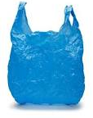
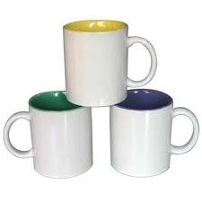
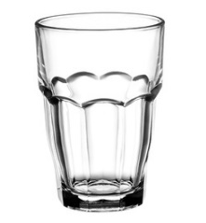
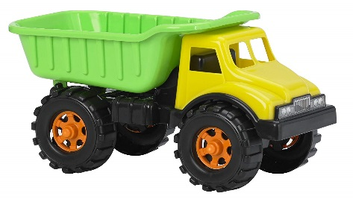
Which items shouldn’t go in my recycle bin?
Placing the wrong items in the recycling is know as contamination. To make sure your recycling efforts don’t go to waste, it is very important that materials such as these do not go into the recycling bin.
Plastic bags full of recycling – please empty recycling out plastic bags
Plastic bags, packets and film
Food scraps or garden waste
Drinking glasses or ceramics
Old clothes and toys
Batteries
Nappies
Polystyrene and foam

Slide 15
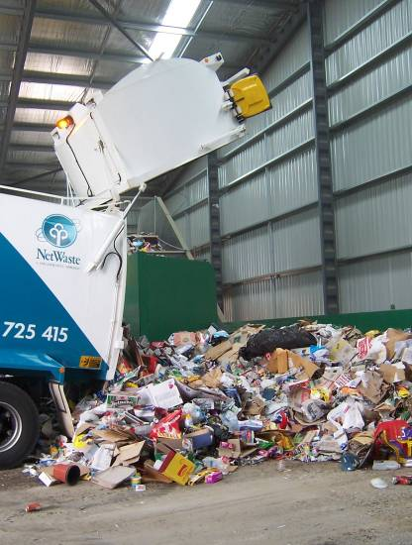
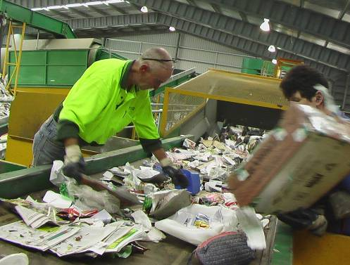
What is a MRF?
Did you know that your recyclables are taken to a Materials Recovery Facility (or MRF)?
At the MRF, all the materials are weighed, sorted and separated by hand and by machine ready for reprocessing into new materials.
Recycling only the correct materials ensures that the people who work at the MRF are not placed at risk and allows the MRF processes to work at maximum capacity.
Notes:
The steps of the MRF;
Pre-sort – MRF staff manually remove contamination from the waste before it travels further into the MRF. This waste is then diverted to Landfill. MRF staff also manually remove paper materials which are transported to a paper mill where they are shredded, bleached and can later be used to form new paper products.
Star Screen Sorting – fans and a series of shafts fitted with rotating discs propel cardboard and paper forwards whilst bottles, cans and containers fall below
Glass – Glass is collected and sorted further by colour before being heated, melted and then blown to form new bottles. Recycling glass equates to significant energy savings.
Magnets – The remaining materials continue through the sorting process where rotating magnets pick up steel cans. Only approximately 30% of steel cans in Australia are recycled, leading to the resource loss of 70% of all steel! In the MRF steel cans are crushed into bales and transported to other companies for reprocessing.
Eddy Currents - As the remainder of the material continues to travel through the MRF an electromagnetic field repels aluminium cans away from the remaining material. Aluminium cans are melted at 700 degrees Celsius and can be used directly to produce industrial products, or made into aluminium sheets which can later be formed into new cans.
Optical Sorting – infrared sensors and air jets sort plastic types 1 (PET) and 2 (HDPE). Similar to the process of glass recycling, recyclable plastic is separated into it’s type and then melted. The melted plastic is then formed into small plastic bottle moulds, which are able to be easily transported to product factories where they are then blown out to become a normal sized plastic container.
Manual Sorting – MRF staff manually sort other plastic types (3 to 7). This plastic is recycled using the same methods as plastic types 1 and 2.

Slide 16
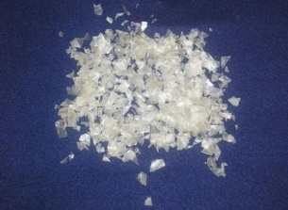
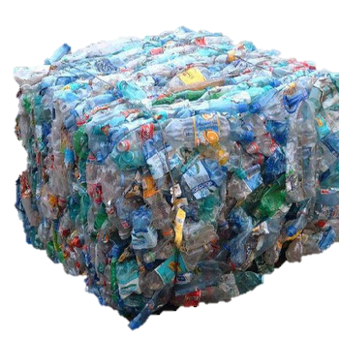
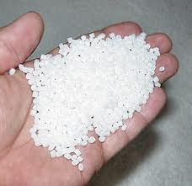
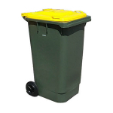
Why recycling counts
Recycling reduces the amount of waste that goes into landfill
This will save the community money in the long term
Recycling helps to conserve natural resources by using the same materials again and again.
This is called ‘closing the loop’
Recycling saves energy and is better for the environment
Notes:
Ask students to think about why recycling materials is better than sending these materials to landfill. Use the example of a plastic bottle. Plastic bottles are baled up at the MRF before being transported to a remanufacturer for further processing. Here the plastic is chipped into flakes before being heated at very high temperatures into resin balls. These are then melted and poured into a preform mould for transportation purposes. The preform moulds are turned into new plastic bottles ready to be filled and sent back to the supermarket.
Introduce the term ‘closing the loop’.

Slide 17
Pledge of Commitment
Make a Pledge of Commitment that your class will honour for the year. You could…
Tell students in other classrooms how they can Avoid, Reduce, Reuse and Recycle
Always use both sides of our paper
Collect and recycle all of our classroom paper
Remove all packets and plastic wrap from our lunch boxes and pack our lunch in reusable containers instead
Bring reusable drink bottles full of water to school every day

